Slide 1
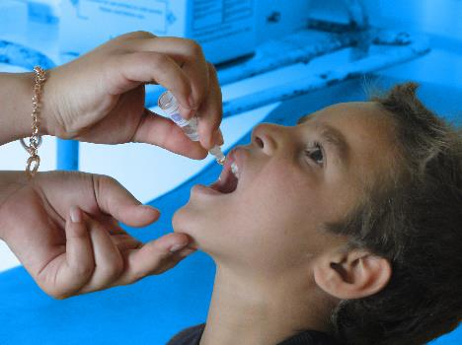
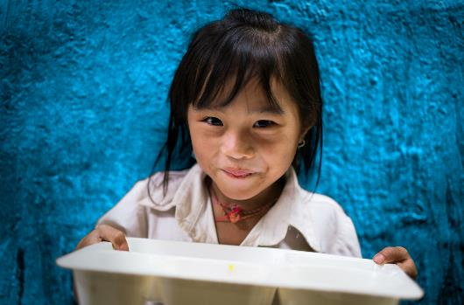
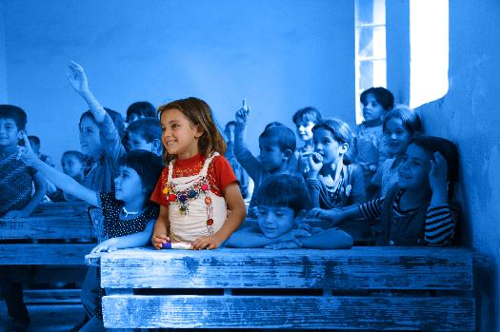
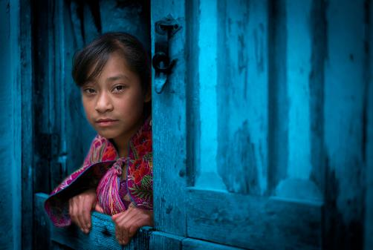
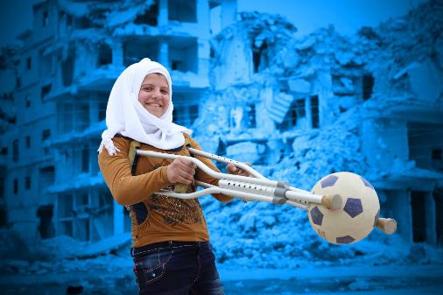
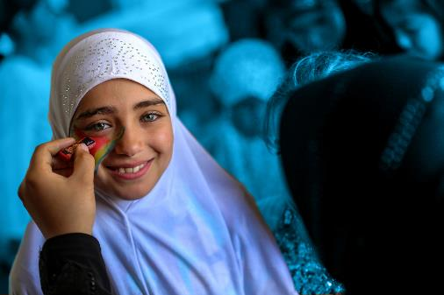
ENDING VIOLENCE AGAINST CHILDREN
Notes:
Delivering this Activity:
*Please Note: UNICEF encourages peer-led learning. If you are a young person delivering this workshop to your peers, follow the steps below for a successful workshop!
Get support from a teacher or adult to run through the workshop with you first.
If it is a challenging issue, that might cause upset to people, only deliver it with the support of an adult in the room. And give prior warning to the participants of topic you are covering as they may or may not wish to participate.
Make sure all the technical things (internet, computer connections, etc) are working before the workshop
Follow the notes and use them to talk through each of the slides and show the different videos. Most slides have notes with more info, but don’t worry if you don't share everything in the notes.
Always encourage discussion during the presentation – being sensitive to everyone’s personal experiences and perspectives.

Slide 2
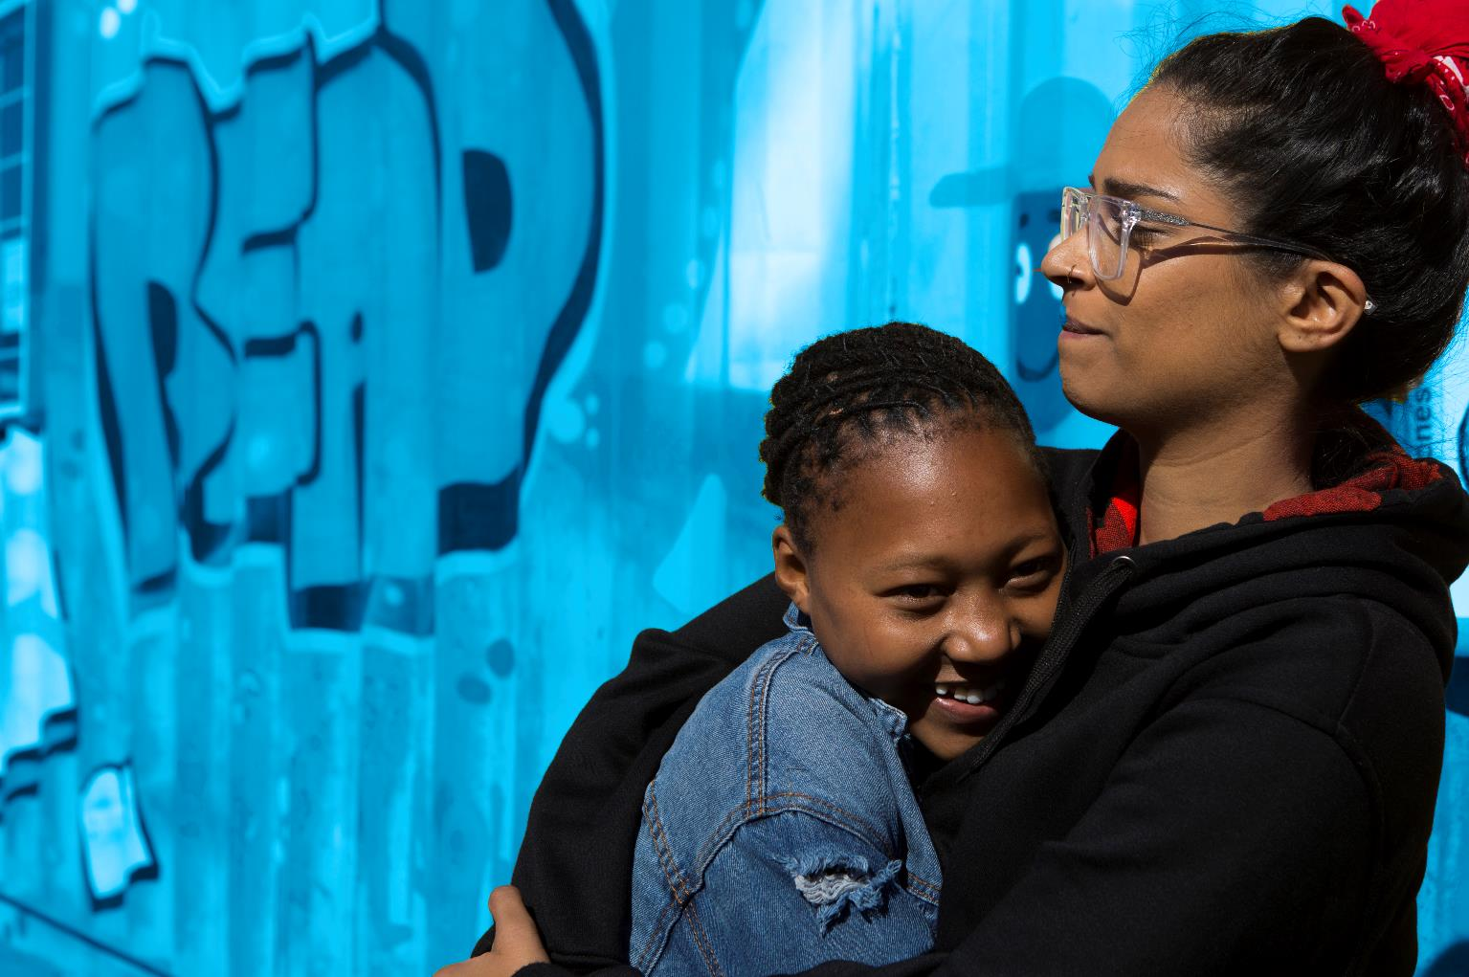
WORKING TOGETHER
RESPECT
CONFIDENTIALITY
PRIVACY
INCLUSION & PARTNERSHIP
AWARENESS
Notes:
Working Well Together - This workshop might touch on some personal experiences you, a family member, or friend has dealt with. ​Because this is an open forum and the discussion might be challenging, please keep in mind the following.
​
RESPECT- Listen when people are speaking, be non-judgmental and respect difference, and don't laugh, deride or make fun of others
CONFIDENTIALITY – Try to ensure that what is said in the room stays in the room
PRIVACY - Only share what we want to share with the group, though we ask for confidentiality, we cannot guarantee it.
INCLUSION – Include everyone, let’s all make sure everybody has an opportunity to contribute if they want to and no one is left out of a group or discussion.
AWARENESS- Be aware this topic might be upsetting If you find the discussion is upsetting you and or you need support please feel free to excuse yourself and find an adult who can support you, be that a teacher, guidance counsellor or a support organisation. X is in the room to support you as well.

Slide 3
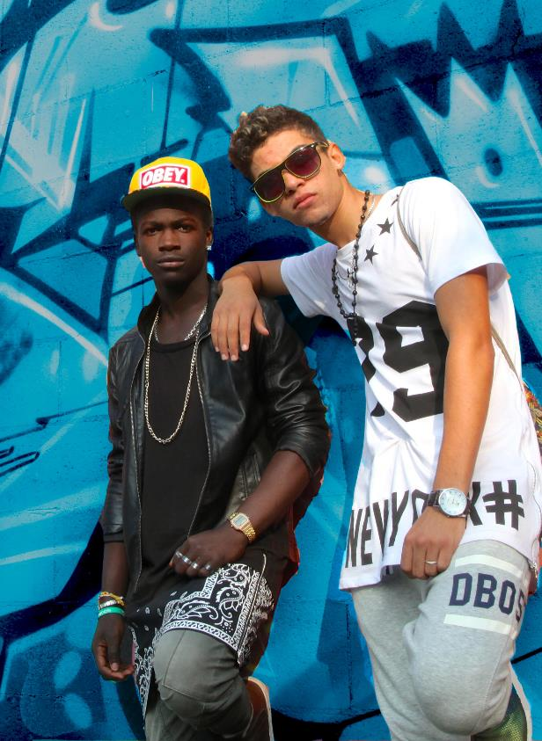
This workshop might touch on some personal experiences you, a family member or friend has dealt with. Because this is an open forum we encourage you not to share personal stories today with the group. If you are in need of professional help we can share with you contact details for organisations that can provide support. If you get upset during the workshop please feel free to leave at anytime and or seek out support from the guidance counsellor or another care provider.
Working Well Together
Privacy - We only share what we want to share
Confidentiality – What is said here stays here
Respect - Listen when people are speaking, respect difference, and don't laugh, deride or make fun of others
Inclusion – We make sure everybody has an opportunity to contribute and no one is left out of a group or discussion

Slide 4
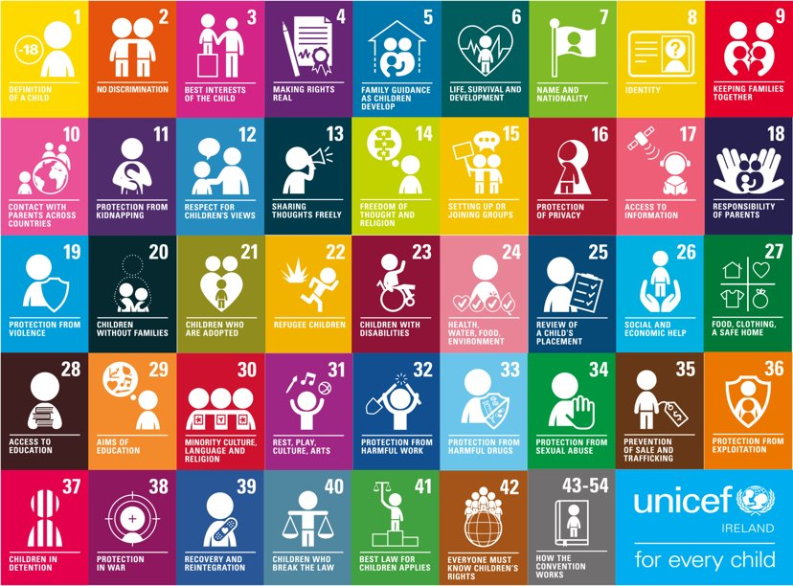
Notes:
The UNCRC is UNICEF’s mandate, there are 54 articles in total with 42 rights in total. Who here today has heard about Children’s Rights? Look at your posters to see your rights. Why do we single out child rights in a separate human rights Convention? Because… Children are more vulnerable than adults they start life as totally dependent beings. Children rely on adults to nurture and guide they need to grow towards independence. Children’s views are rarely heard and considered in the political process. Children cannot vote or take part in political processes. We all only get one childhood and that needs to be protected.

Slide 5
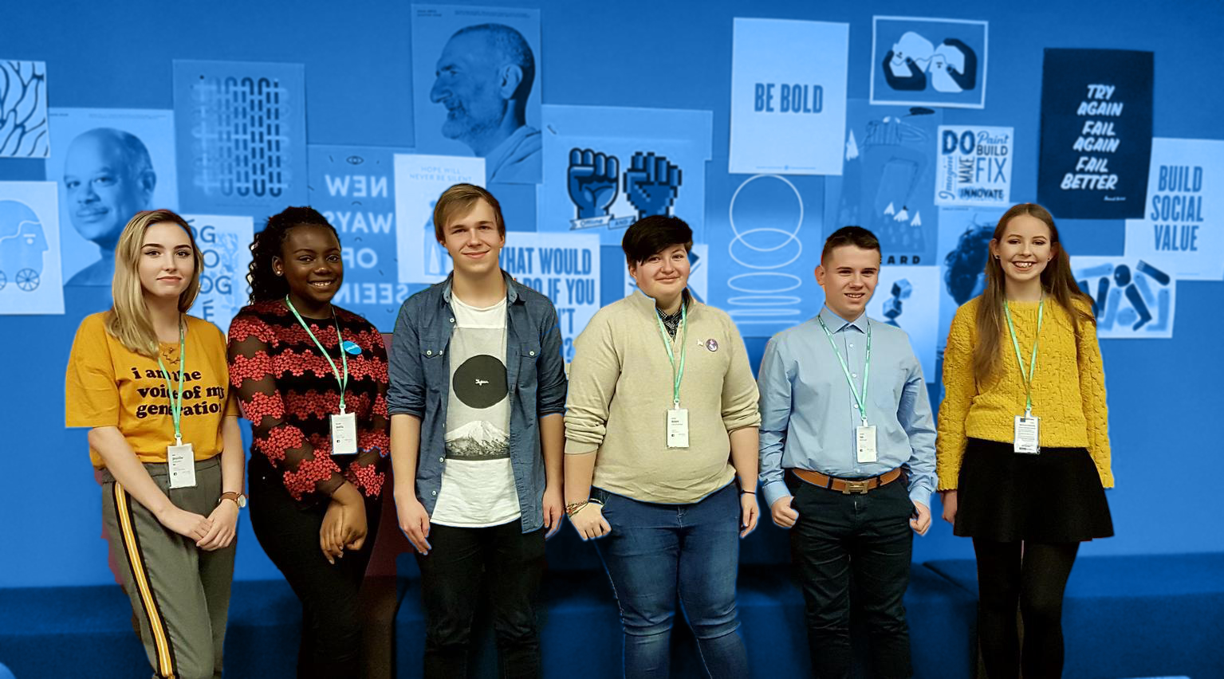
CROSS THE LINE
Notes:
The aim of this activity is to open the discussion around violence against children and get participants to reflect on its impact. Create/Draw a line in the middle of the room, ask children to step across the line in answer to a statement read out.
Cross the line if you agree, violence against children includes all forms of violence against people under 18 years old, whether perpetrated by parents or other caregivers, peers, romantic partners, or strangers. - True
Cross the line if you agree that experiencing violence in childhood impacts lifelong health and well-being. – Violence can result in death, injury, can impair brain development, impact on learning, result in harmful risk taking behaviours, increase risk of non-communicable disease
Violence against children is ok if it is an accepted cultural practice Violence against children in all its forms, from the slap of a parent to the unwanted sexual advance of a peer, is harmful, morally indefensible and a violation of every child’s fundamental human rights.
Cross the line if you know a bully – Get the group to pause and reflect how this person makes them feel and what might this person feel of themselves.
Cross the line if you feel violence is normal and condoned in our society. – Get the group to pause, reflect and discuss their views
Cross the line if you enjoy watching violent acts. – Get the group to pause, reflect and discuss why, why not
Cross the line if you have used violence to get your way – Get the group to pause, reflect and discuss.
Cross the line if you feel violence is a problem in your school Get the group to pause, reflect and discuss.
Cross the line if you are friends with a bully Get the group to pause and reflect
Cross the line if you feel safe from violence. Get the group to pause and reflect
Cross the line if you agree that 1 billion children aged 2–17 years, have experienced physical, sexual, or emotional violence or neglect in the past year (1). Get the group to pause, reflect and discuss.
Cross the line if you agree slapping a child to discipline in exceptional circumstances is ok. - Get the group to pause, reflect and discuss. Explain it is a violation of their rights - Violence against children in all its forms, from the slap of a parent to the unwanted sexual advance of a peer, is harmful, morally indefensible and a violation of every child’s fundamental human rights.
Cross the line if you or someone you know has experienced bullying. Get the group to pause and reflect on what they did to support that person.
Cross the line if you feel violence is a problem in your community – Get the group to pause, reflect and discuss their views
Cross the line if you see violence as an acceptable way to solve a dispute– Get the group to pause, reflect and discuss their views
Cross the line if words you have spoken to another person could have caused hurt -Get the group to pause and reflect on why you did this
Cross the line if you agree that violence against children can be prevented. - – Get the group to pause, reflect and discuss their views
Cross the line if you are willing to act to prevent violence against children - Get the group to pause and reflect on how or what they would do.
Cross the line if you have ever crossed a line that you regret - Get the group to pause and reflect on that moment and how you would have changed things or how you could make amends.
Feedback and closure: Ask the group to write down a statement that reflects what if anything the gained from the exercise and what they would hope to discuss further on the issue of violence against children.

Slide 6
Notes:
Watch the David Beckham video highlighting the many forms of violence against children.

Slide 7
WHERE IN THE WORLD
Notes:
Divide participants in to 7 groups.
Ask each group to watch their video and discuss amongst themselves the topic. Questions to discuss. Your thoughts on the video/issue, What rights are not being protected for these children? What is the root cause of this issue? How many children do you think are impacted by this issue? Describe what children experience as a result of this issue. Describe what actions you think need to happen to protect children from this issue? Have children in Ireland experienced this issue? What actions could you take to tackle this issue?
Feedback discussion: Ask the group to feedback their discussions to the wider group. As an extension as the group to research the issue and present back to the group the scale, scope, root causes, Have children in Ireland experienced this issue, current campaigns to address the issue. Are there any actions the group will take on this issue why/why not

Slide 8
TACKLING VIOLENCE AT SCHOOL
Define the problem
Design a survey to understand the scale
Co-ordinate the delivery of the survey
Audit policies and procedures
Collate and assess the data
Present your findings to the school
Research evidence based interventions
Develop a rights based action plan
Deliver it
Notes:
Discussion: Bullying is an act of violence and abuse. Being safe at school is a fundamental human right. Every child and youth has the right to be safe and free from the harmful effects of bullying. Article 19 of the CRC addresses the rights of children who are at the receiving end of bullying and harassment: Parties shall take all appropriate legislative, administrative, social and educational measures to protect the child from all forms of physical or mental violence, injury or abuse, neglect or negligent treatment, maltreatment or exploitation, including sexual abuse, while in the care of parent(s), legal guardian(s) or any other person who has the care of the child. Violence, abuse and bullying are a violation of your rights whether it happens in the home on the street or in school.
Just like crime in our communities, bullying needs to be prevented through continual awareness-raising, monitoring and responding effectively to incidences. Studies have shown that for achieving the best results, everyone within the school community must play a role. The following activities provide you with a starting point to activate or reactivate your bullying prevention programmes. Defining the problem: Understanding the problem in your school and within each year group can be helpful to tailor your response. This activity can be done through a classroom discussion or a wider school survey. Find out what types of bullying is going on, where it is happening, how visible it is and who it is directed at, and how effective the responses are. Take action on the results with the support of the school.
Step 1: Define bullying - Write each question on a separate A4 sheet of paper.
What are the different types or examples of bullying?
How does bullying impact on individual and school community?
What role does power and or social hierarchy play in bullying, what are the social divides in your school eg, socio-economic, race, appearance, sexuality?
Where and when does bullying occur and is it worse in a certain year group or peer group?
How is bullying prevented and or responded to in your school & is it effective?
Who are the people considered most at-risk groups of bullying and how are they protected? While bullying can happen to any pupil, it is known that some may be more vulnerable to or at risk of experiencing bullying. Such vulnerable groups include pupils with disabilities or special educational needs, those from ethnic minority and migrant groups, pupils from the Traveller community, lesbian, gay, bisexual or transgender (LGBT) pupils and those perceived to be LGBT and pupils of minority religious faiths. (DES, 2013; 4.3.2)
Give each row or group of students one of the six questions to answer. Ask each person to add their contribution to the answer and then pass the paper to the next person. The last person can read that answer to the class.
Step 2: Build a survey - Form groups based on the questions and formulate 3-5 questions to add to a survey of their, class, year, or school (depending on permission received).
Step 3: Make a Plan- Conclude by reading out the survey and asking if there are any questions that should be added to the survey. Determine how the group will carry out the survey and what actions can be achieved with the results.
Step 4 - Extension: Take Action - Based on the survey findings, take actions that could improve the situation in your school.
Examples include:
Presentation on the findings: students at an assembly or newsletter and or to board of management, school principal/deputy, PTA in a meeting.
Policy review: Anti-bullying policies; Do you know the policies and processes that are undertaken in your school to deal with bullying and violence against children. Are they reviewed regularly, are they communicated well, who has the oversight are young people part of the process, how often are students, teachers, parents surveyed to ensure procedures and monitoring is effective.
Awareness Raising Campaign: Established evidence-based intervention strategies. What awareness-raising campaigns are out there that you think could address the problem in your school? TackleBullying.ie
Rights-based charter: Develop and distribute a rights-based charter with the whole school and ensure every student receives their own copy of the charter.

Slide 9
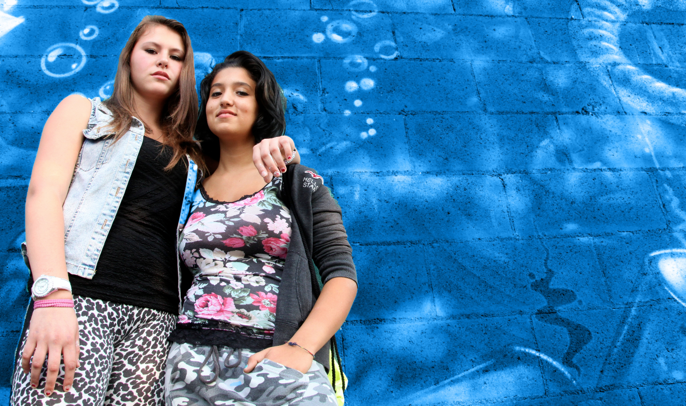
LIKE YOU…
Notes:
The aim of this activity is to build empathy and solidarity with their peers.
Step 1: Get everyone to close their eyes. Ask them to think of the people in school and picture a person who they think could be vulnerable to bullying, violence, discrimination. They might be someone who has a disability, someone who is socially awkward, someone who is too popular, someone who stands out because of their race, their nationality, their sexuality, someone who is dealing with poverty or a health concern. Face them in your mind and take their hands in your hands and look them in the eyes. Notice what you have in common with them.
Step 2: Read out the following sentences.
Like you, they are human,
Like you, they have rights,
Like you, they have hopes and dreams,
Like you, they want to feel a connection,
Like you, they want to be liked,
Like you, they want friendship,
Like you, they want to feel safe,
Like you, they want to be included,
Like you, they sometimes feel lonely,
Like you, they sometimes feel hurt,
Like you, they sometimes feel sad,
Like you, they have felt anger and resentment,
Like you, they can feel inadequate,
Like you, they need support from their peers,
Like you, they need school to be safe,
Like you, they need to feel loved,
Now make a wish for them, this can be that they feel happy, that they have their needs met, that they succeed, whatever wish you want.
Now pledge something you can do to support them.
Open your eyes in your own time
Step 3: Hand out a card to participants. Ask them to write down a pledge/commitment that they will take to prevent bullying and violence in their school. Based on the “Just Like Me” exercise from nobully.org

Slide 10
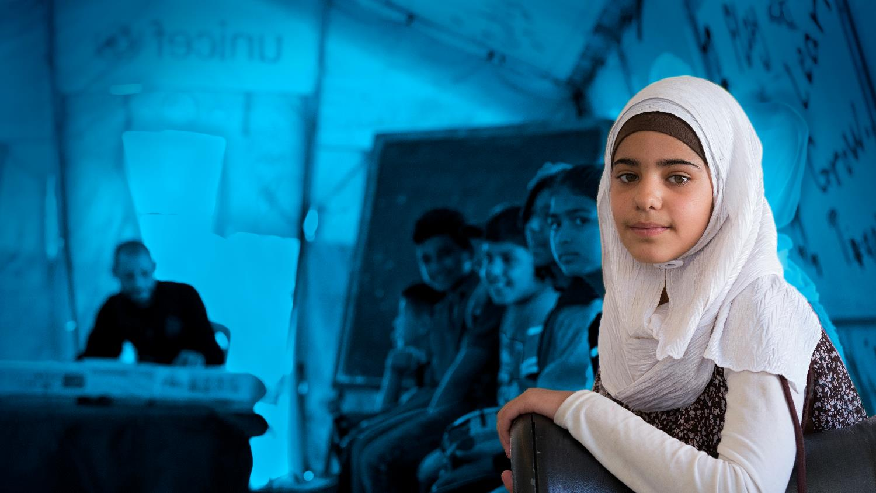
Topic Goals:
Global Goal 4 (Quality Education) calls for safe, non-violent, inclusive and effective learning environments for all.
Global Goal 16 (Peace and Justice) calls for ending abuse, exploitation, trafficking and all forms of violence against and torture of children.
Notes:
We all have responsibility for achieving the Sustainable Development Goals by 2030. Below are the goals and their targets that address violence against children. Use them, along with the Convention on the Rights of the Child to support your call to take action and address these issues. Below are just a few suggestions of actions you can take.
Target 4.a ...provide safe, non-violent, inclusive and effective learning environments for all
TAKE ACTION:
Carry out a school survey to find out the extent of the problem at your school.
Audit and review the effectiveness of school policies and procedures to tackle violence and bullying.
Run a campaign to empower students to speak up and take positive action.
Target 5.3 eliminate all harmful practices, such as child, early and forced marriage and female genital mutilations.
TAKE ACTION:
Campaign to promote positive social norms and gender equality.
Raise awareness of gender-based violence in your school.
Ensure your RSE programme covers consent, sexual violence and violence within intimate relationships.
Target 8.7...secure the prohibition and elimination of the worst forms of child labour, including recruitment and use of child soldiers, and by 2025 end child labour in all its forms.
TAKE ACTION:
Inform yourself and raise awareness of child labour among your peers.
Find out what companies, products and services are known to use child labour and make ethical choices in what you buy.
Campaign to ensure your peers know their labour rights in Ireland.
Target 11.7 ....Provide universal access to safe, inclusive and accessible, green and public spaces, in particular for women and children, older persons and persons with disabilities.
TAKE ACTION:
1. Join or start a youth group in your community that aims to reduce street violence and promote inclusivity.
2. Carry out a community mapping of safe and unsafe places in your community and or around your school and present results to your local council.
3. Advocate for increased and better use of investments targeted at ending violence in your community.
Target 16.2 End abuse, exploitation, trafficking and all forms of violence against and torture of children.
TAKE ACTION:
Learn more about the issue of violence against children and effective ways to prevent it.
Raise awareness in your school about violence against children and the services available to support children and families.
Educate and empower children, parents, teachers and community members to recognize and safely report violence in all its forms.

Slide 11
Text SPUNTOUT to 0861800280 or go online to spunout.ie
Call 1800666666 or chat online at childline.ie or text to 50101 10-4pm
Call 1800544729 or text “call me” to 0861802880
Call 116123 or 24/7 or email jo@samaritans.org
Call 1800247247 or text HELP to 51444 if feeling Suicidal/Self Harm
Call 016706223 or go to website belongto.org support for LGBTI+
SUPPORT
Notes:
Leave this up at the end of the workshop

