Slide 1
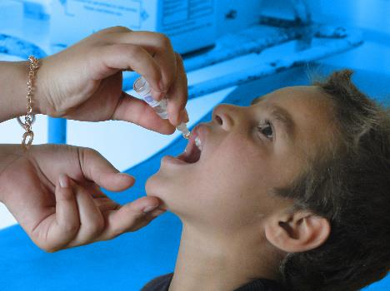
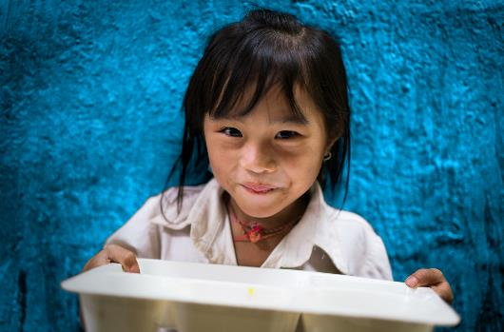
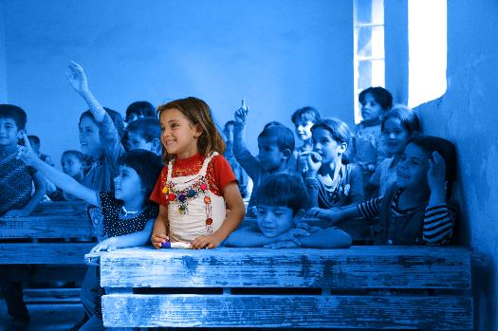
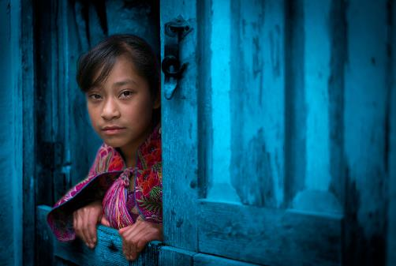
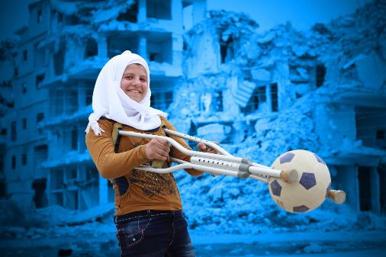
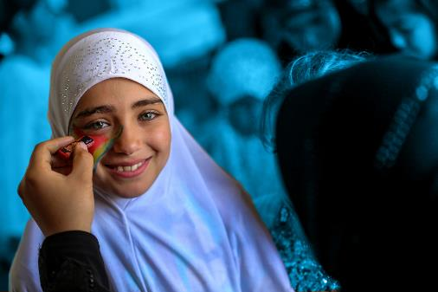
GENDER EQUALITY
Notes:
Delivering this Activity:
*Please Note: UNICEF encourages peer-led learning. If you are a young person delivering this workshop to your peers, follow the steps below for a successful workshop!
Get support from a teacher or adult to run through the workshop with you first.
If it is a challenging issue, that might cause upset to people, only deliver it with the support of an adult in the room. And give prior warning to the participants of topic you are covering as they may or may not wish to participate.
Make sure all the technical things (internet, computer connections, etc) are working before the workshop
Follow the notes and use them to talk through each of the slides and show the different videos. Most slides have notes with more info, but don’t worry if you don't share everything in the notes.
Always encourage discussion during the presentation – being sensitive to everyone’s personal experiences and perspectives.

Slide 2
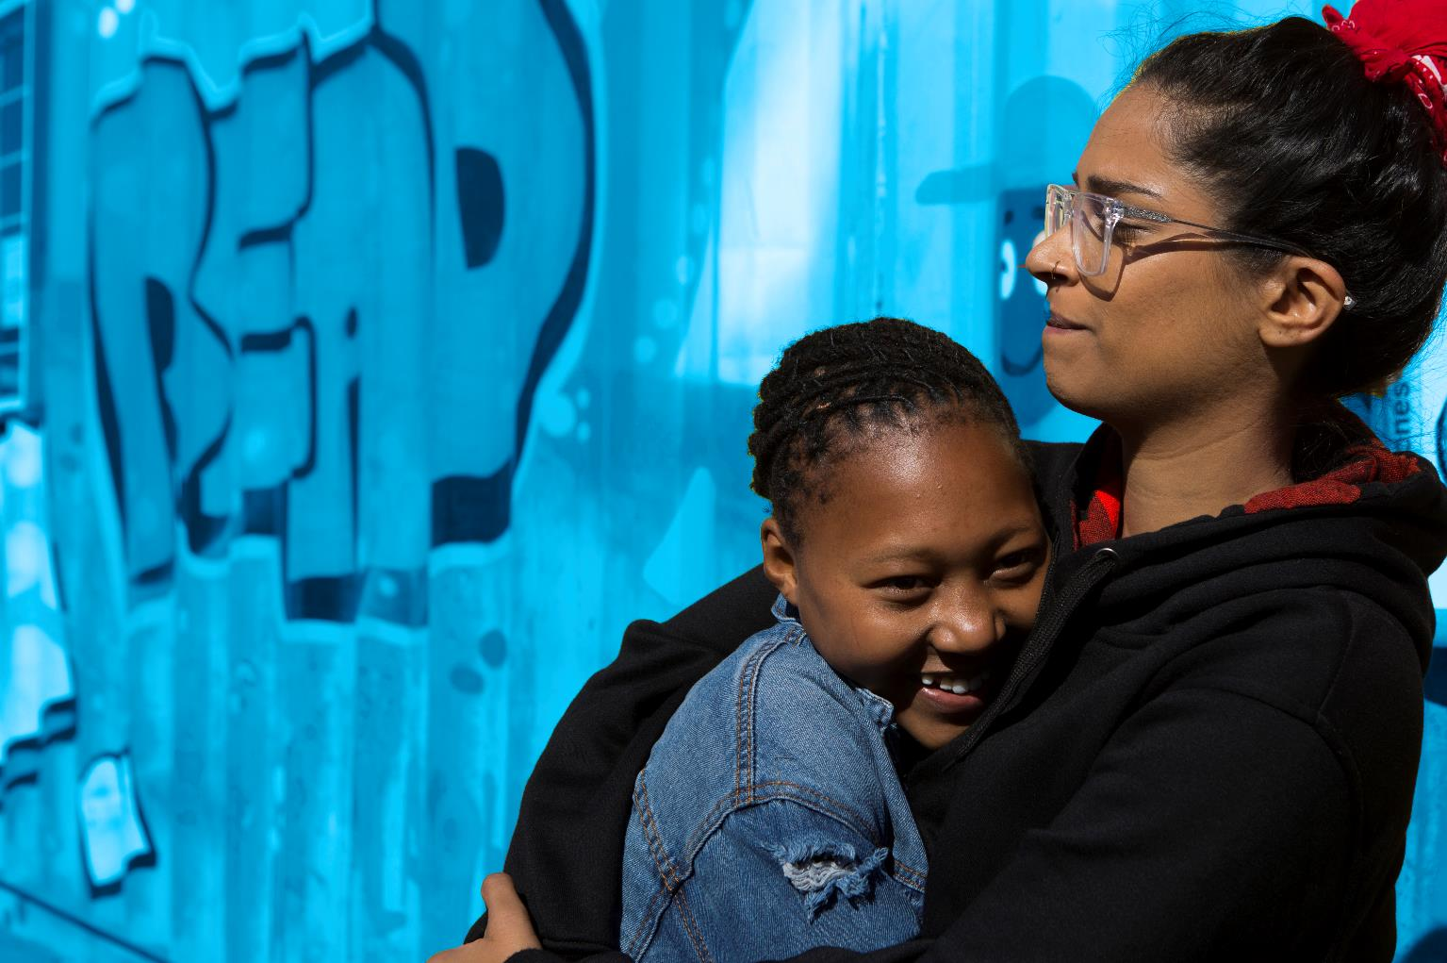
WORKING TOGETHER
RESPECT
CONFIDENTIALITY
PRIVACY
INCLUSION
AWARENESS
Notes:
RESPECT- Listen when people are speaking, respect difference, and don't laugh, deride or make fun of others
CONFIDENTIALITY – What is said here stays here
PRIVACY - We only share what we want to share
INCLUSION – We make sure everybody has an opportunity to contribute and no one is left out of a group or discussion.
AWARENESS Sometimes the topics and discussions can be upsetting or you have been personally affected by them. If you have been upset or want to just talk please come to Vivienne for support.

Slide 3
Notes:
UNICEF stands for the United Nations International Children’s Emergency Fund
We work in over 190 countries worldwide. This is a short video about who we are.

Slide 4
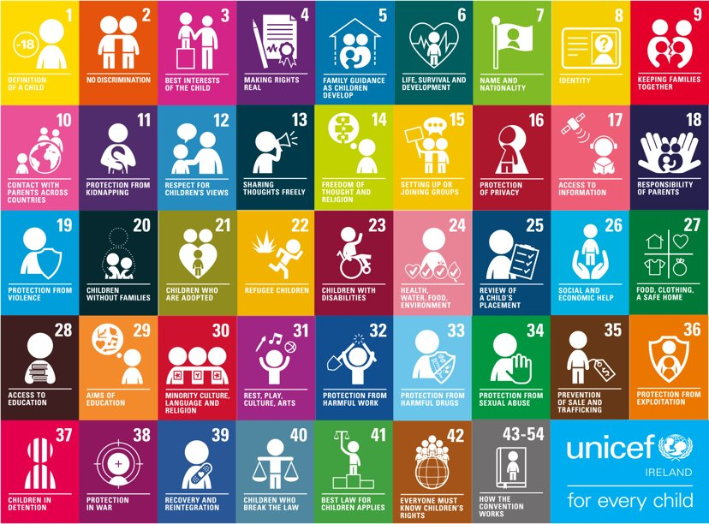
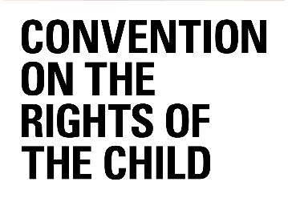
Notes:
The UNCRC is UNICEF’s mandate, there are 54 articles in total with 42 rights in total. Who here today has heard about Children’s Rights? Look at your posters to see your rights. Why do we single out child rights in a separate human rights Convention? Because… Children are more vulnerable than adults they start life as totally dependent beings. Children rely on adults to nurture and guide they need to grow towards independence. Children’s views are rarely heard and considered in the political process. Children cannot vote or take part in political processes. We all only get one childhood and that needs to be protected.
Children’s rights are human rights for children. The 1989 United Nations Convention on the Rights of the Child is an international legal agreement (or ‘treaty’) that recognizes specific rights for children. ‘Rights’ are entitlements every child should have. All children have the same rights. These rights are listed in the Convention on the Rights of the Child and almost every country has agreed to respect them in practice. All the rights are connected, and all are equally important — they cannot be taken away from children. Children have the right to: • Protection (e.g. from violence, exploitation and harmful substances) • Provision (e.g. for education, health care and an adequate standard of living) • Participation (e.g. to be heard and taken seriously, and to join organizations) • Specific protection and provisions when part of a vulnerable population, such as indigenous children and children with disabilities The Convention on the Rights of the Child sets out these rights in 54 articles and in a set of ‘Optional Protocols’ which list additional rights. The Convention is guided by four general principles: nondiscrimination (Article 2), the best interests of the child (Article 3), the right to life, survival and development (Article 6), and the right to be heard and taken seriously (Article 12). UNICEF is the only organization specifically named in the Convention as a source of expert assistance and advice. According to its mission statement, “UNICEF is guided by the Convention on the Rights of the Child and strives to establish children’s rights as enduring ethical principles and international standards of behaviour towards children”.

Slide 5
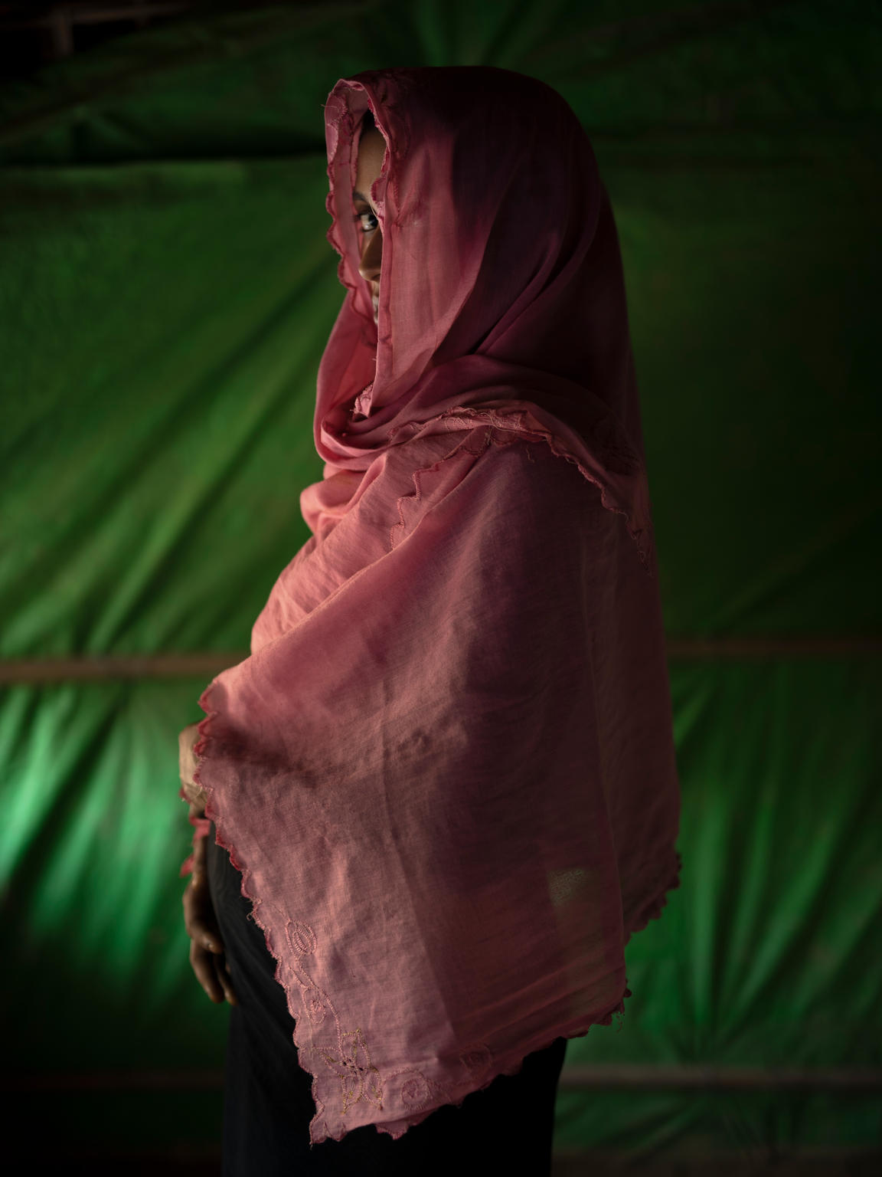
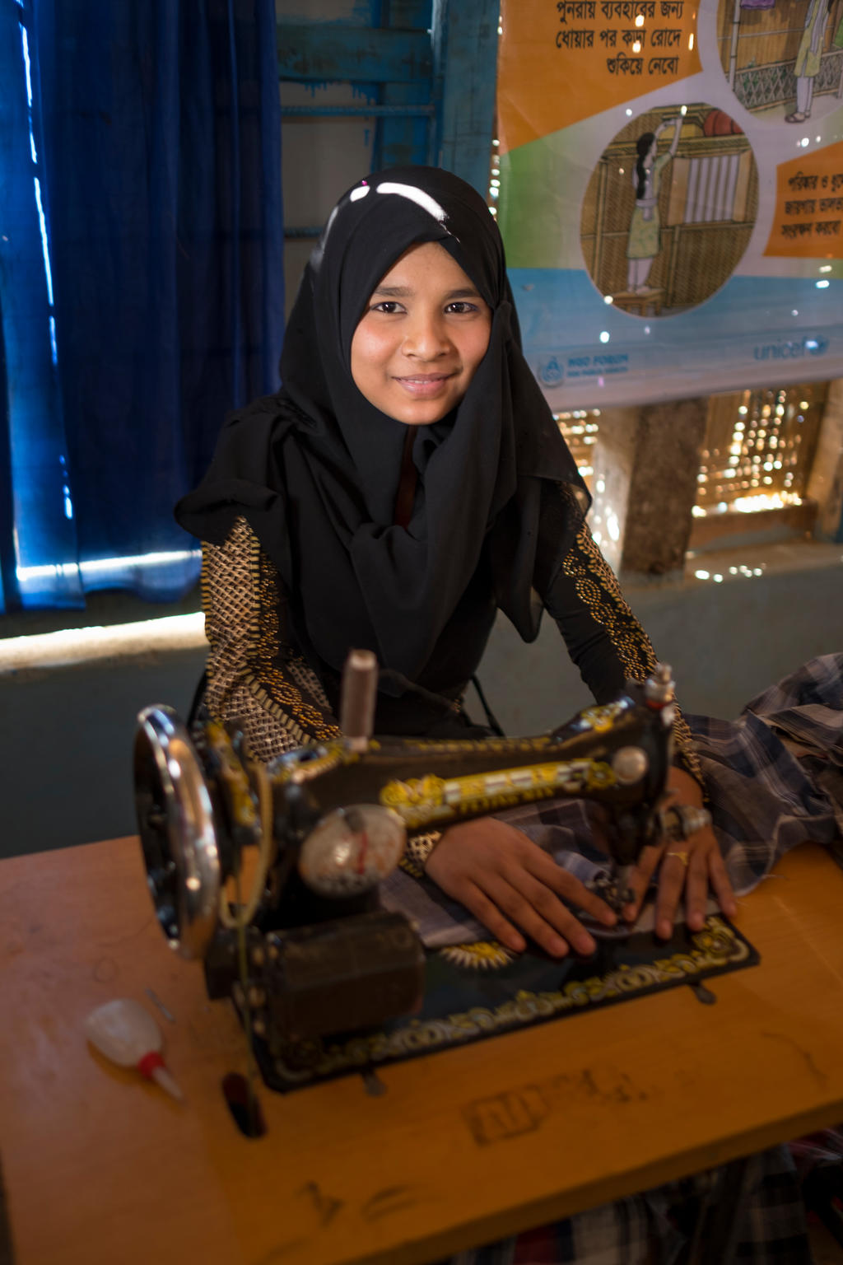
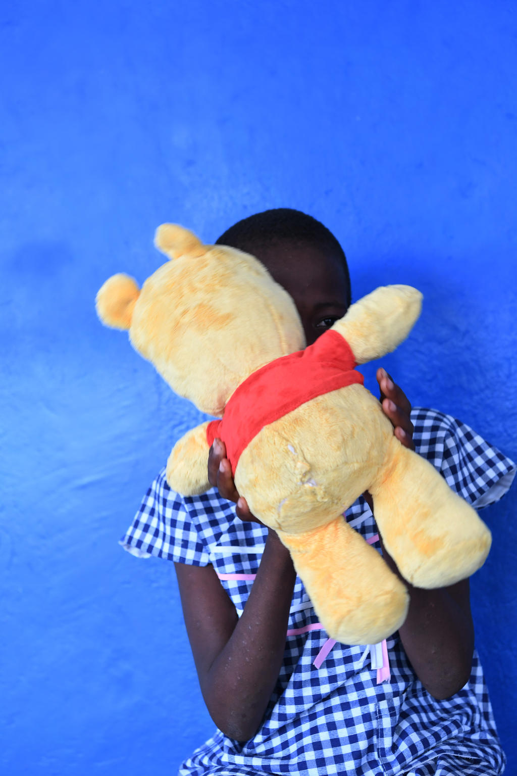
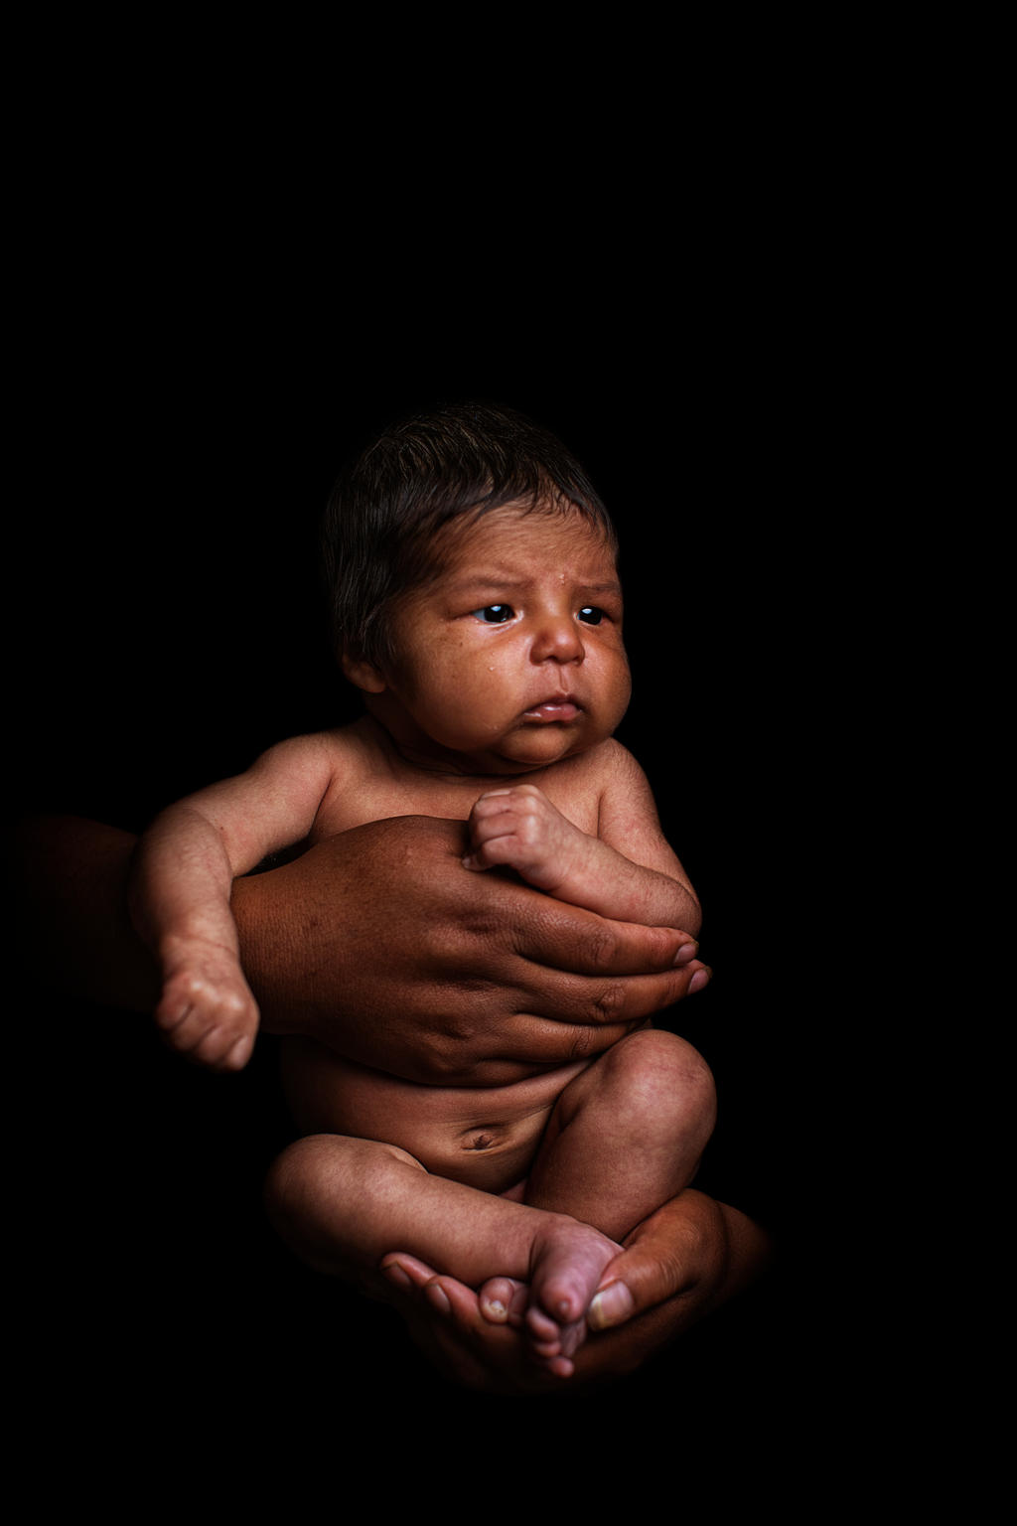
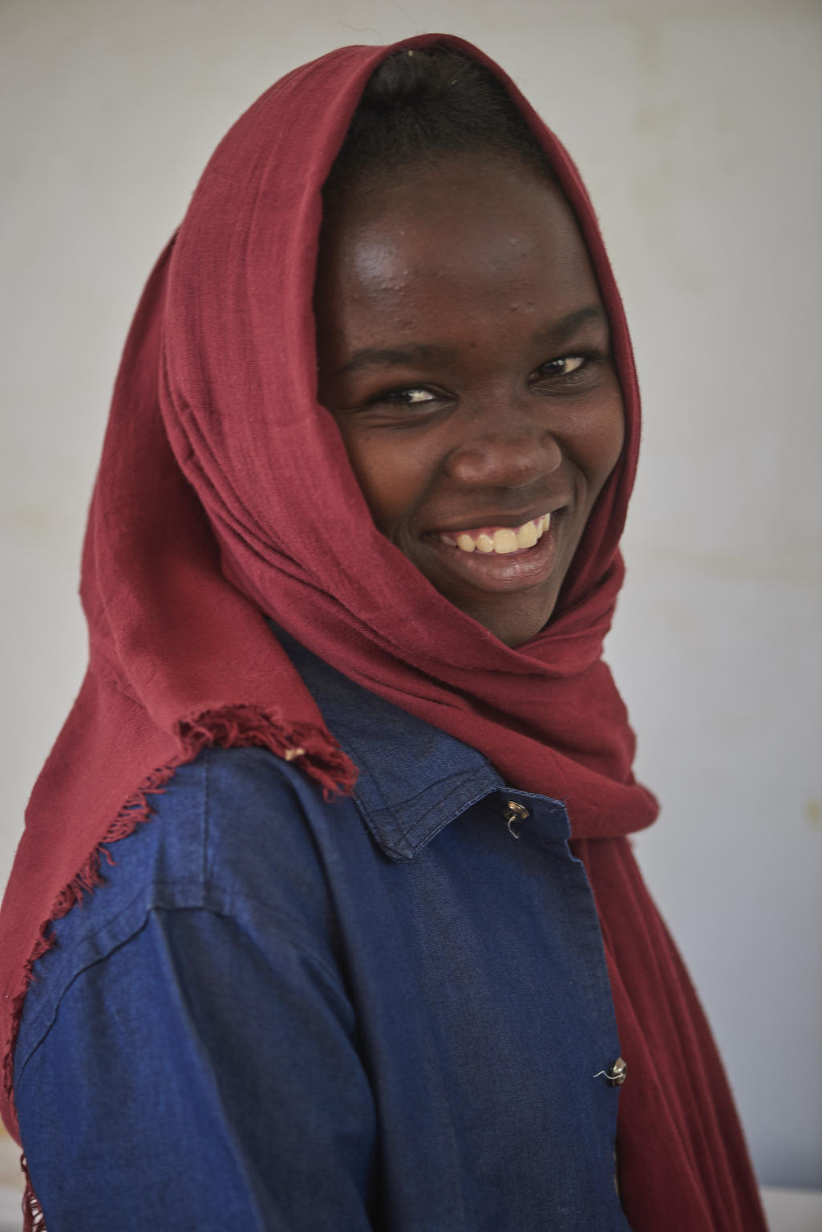
12 million girls are married before the age of 18, each year. That is nearly one girl every 2 seconds that loses her childhood. 1 in 5 women was married before their 18th birthday. (UNICEF)
Around the world, 132 million girls are out of school, girls’ access to education is the lowest worldwide, especially at the secondary level. (UNICEF)
Girls are disproportionately affected by HIV/AIDS, 62% of adolescents 15-19 living with HIV are girls. (UNICEF)
Today 126 million baby girls are believed to be missing as a result of gender-biased sex selection.
(UNFPA)
Each year, over 4 million girls are at risk of undergoing FGM. Most girls are cut before the age of 15. (UNICEF)
Notes:
What do these girls have in common? The experience different lives and lower life outcomes simply because they are girls

Slide 6
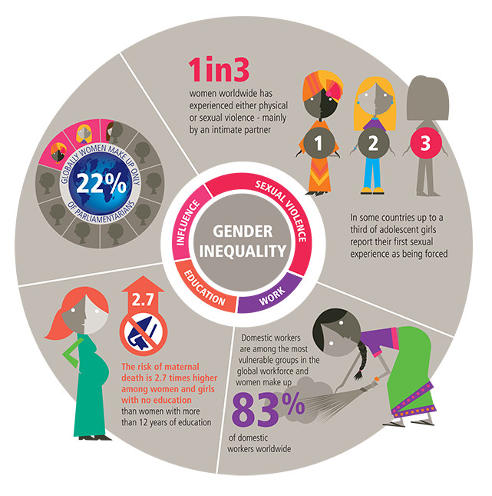
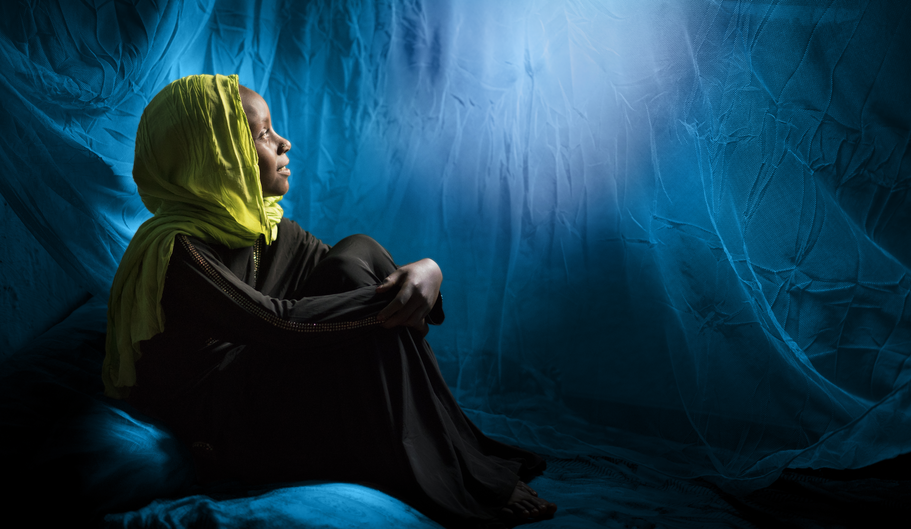
Notes:
The world does have a plan and it is called the Global Goals or the SDGs
This plan aims to make the world more sustainable, fairer and safer for every global citizen by 2030. to achieve this, 17 goals with 169 targets have been agreed and all countries are responsible to achieve them nationally and globally.
What is unique about this agreement is that
It went through a long process of consultation with people from around the world representing many different groups including children and young people.
As I said the agreement is Universal so every nation, city, business, school, organisation, are challenged to achieve the goals
Something to note too is that the Goals are interconnected, we can’t achieve one without the other if there is poverty in the world you can’t end hunger. You can’t end hunger and poverty with out a healthy planet and without addressing the rapid rise of inequality.
What goals are mostly related to the issue we are discussing today? 7-12-13-14-15

Slide 7
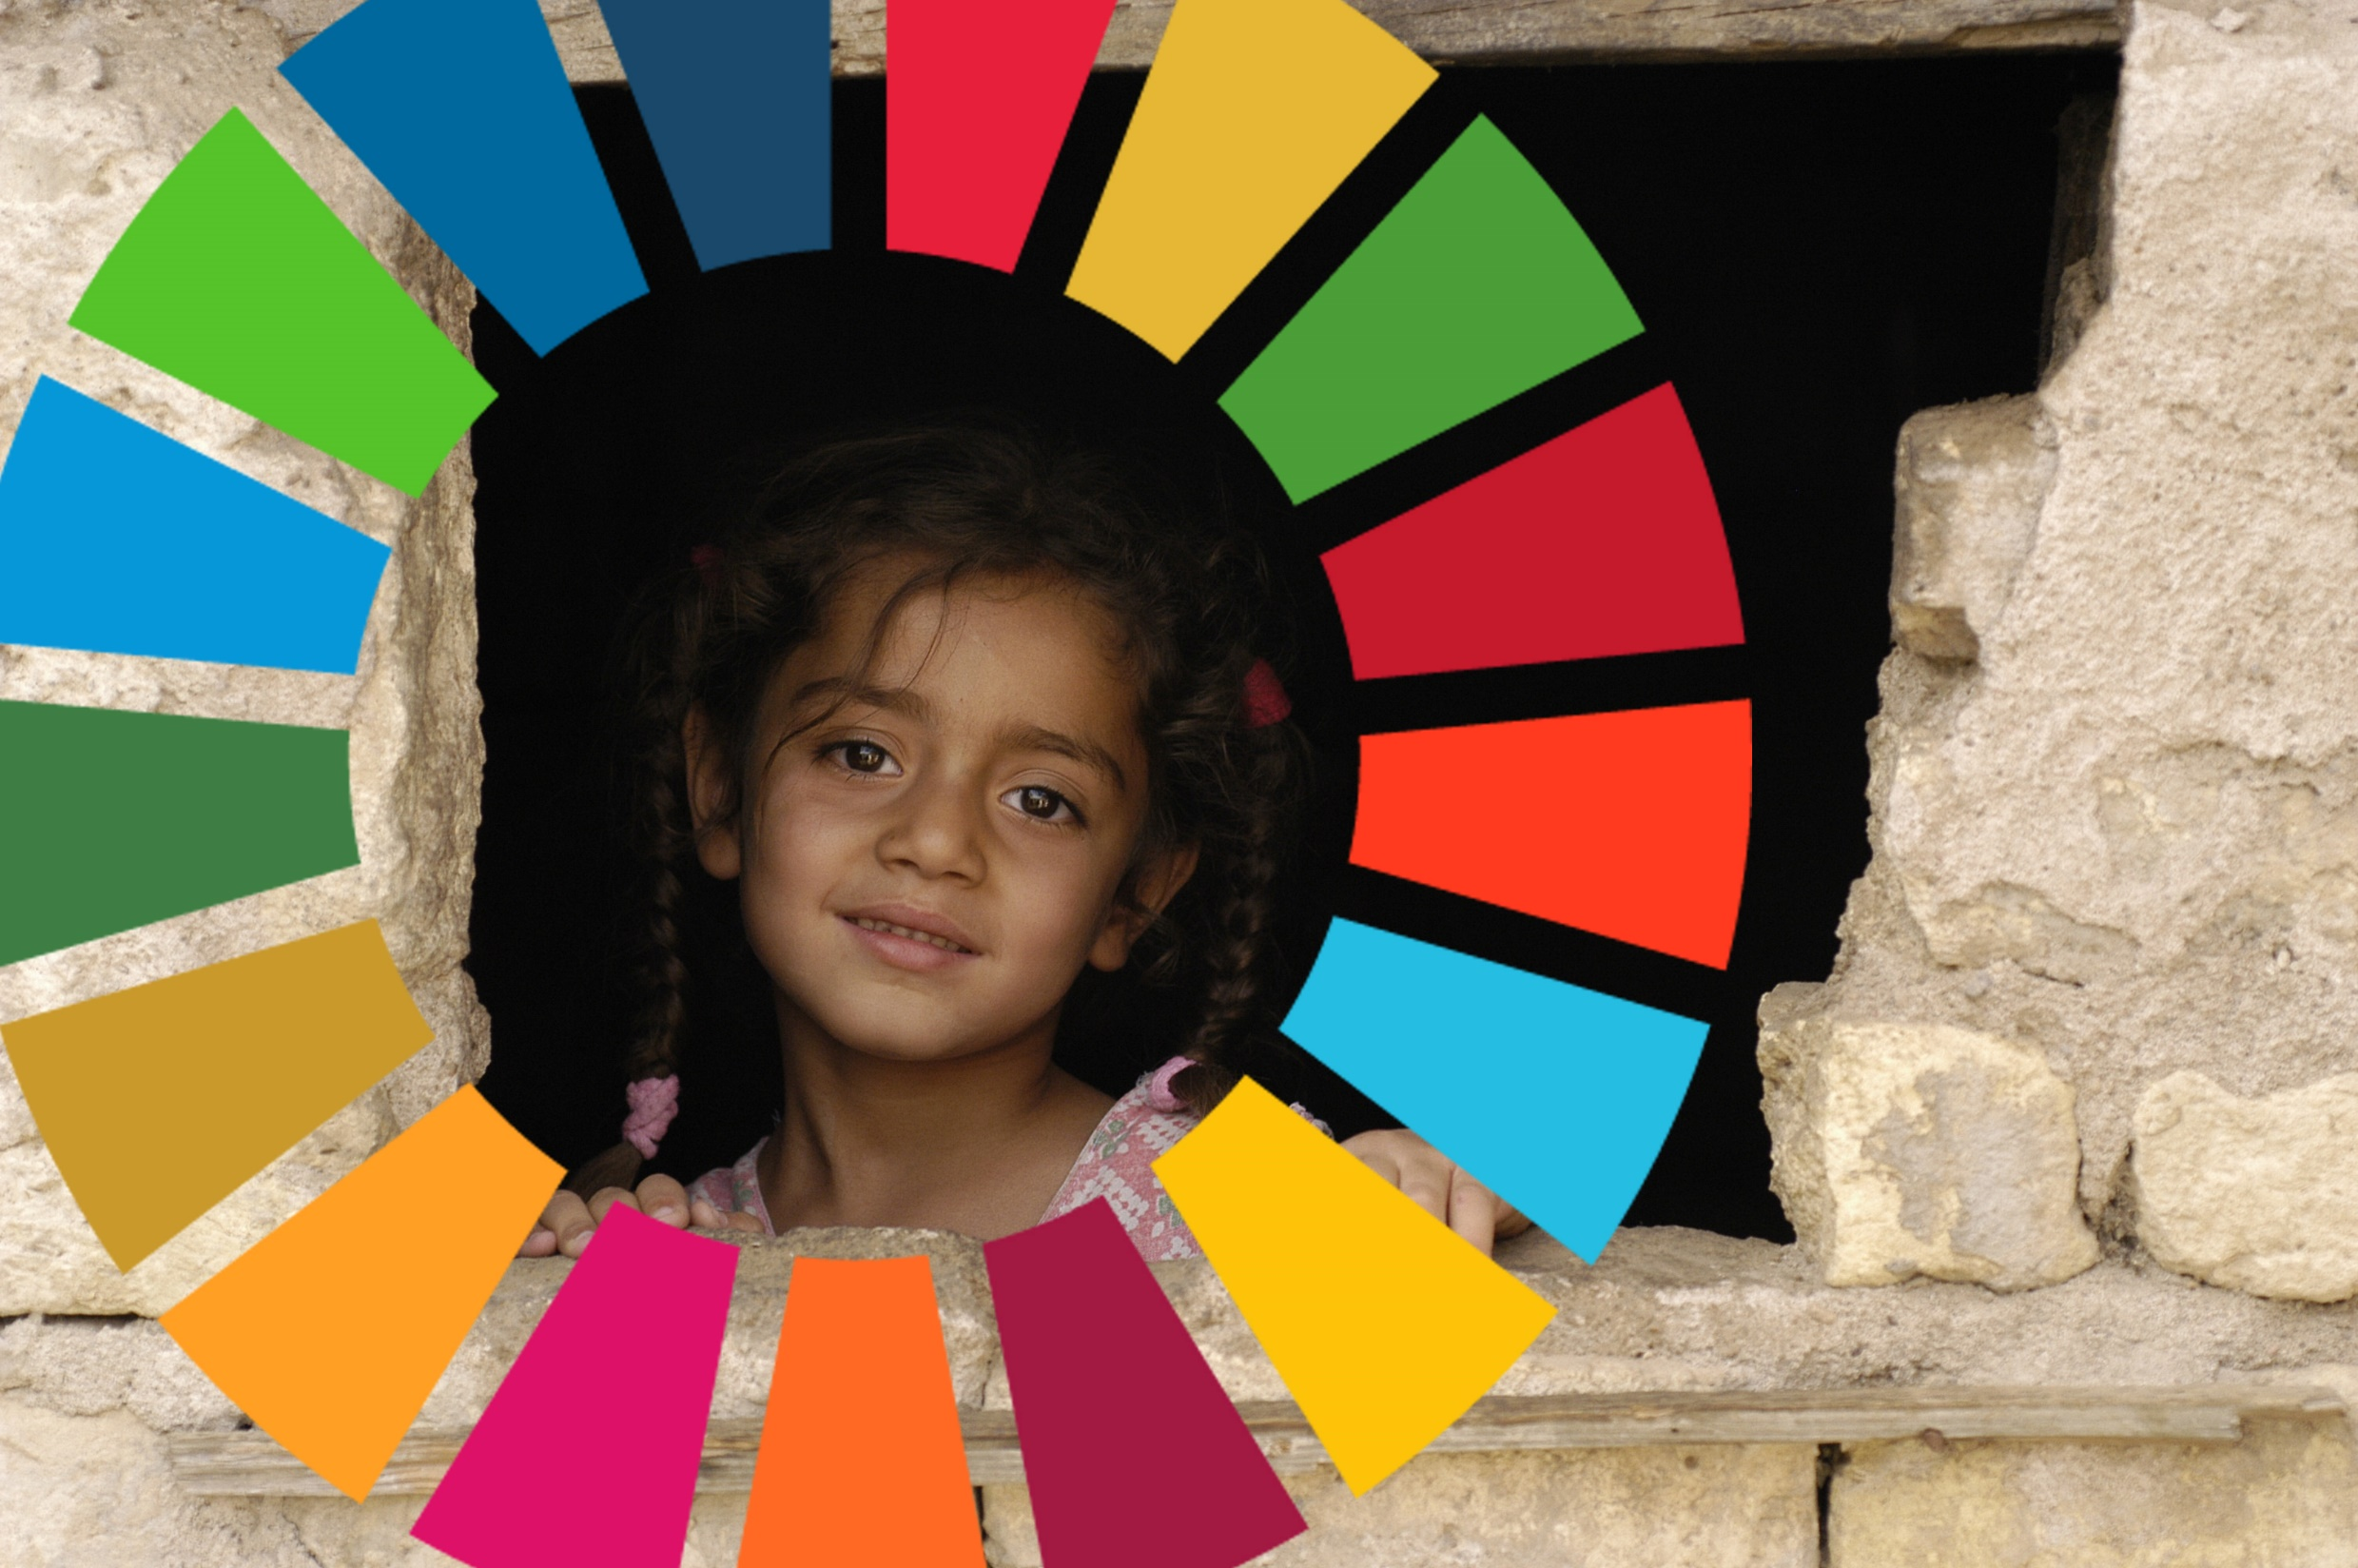
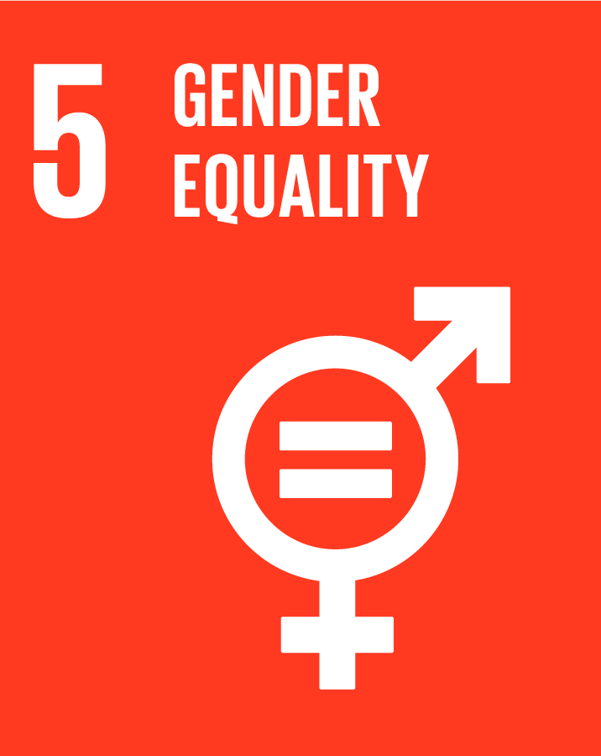
Notes:
SDG 5 aims at achieving gender equality by ending all forms of discrimination, violence, and any harmful practices against women. It recognises the need for equal rights and opportunities for female leadership at all political and economic decision-making levels.
Why does gender equality have a goal in and of itself? Speak to the person next to you and ask
How might outcomes be different for girls if we achieved this globally.
This lesson will look at the topic of gender equality and the differences between men and women. Of course there are some differences in their bodies, but this is what we call sex, not gender. Gender refers to how society sees men and women, or what is masculine and what is feminine. Note: a more detailed explication of the differences between sex and gender can be found at the World Health Organisation website: http://www.who.int/gender/whatisgender/en/ In this lesson we will discuss stereotypes, how they are created and the effect they have on people. It will show especially how stereotypes have helped create ideas of what genders can and cannot do. As an example of this we will have a look at the history of women’s rights, especially the right to vote. After that it will give some statistics that show that, even though men and women are supposed to be equal, the reality shows that this is not often the case. Finally we will explore what people can do to remove these inequalities.

Slide 9
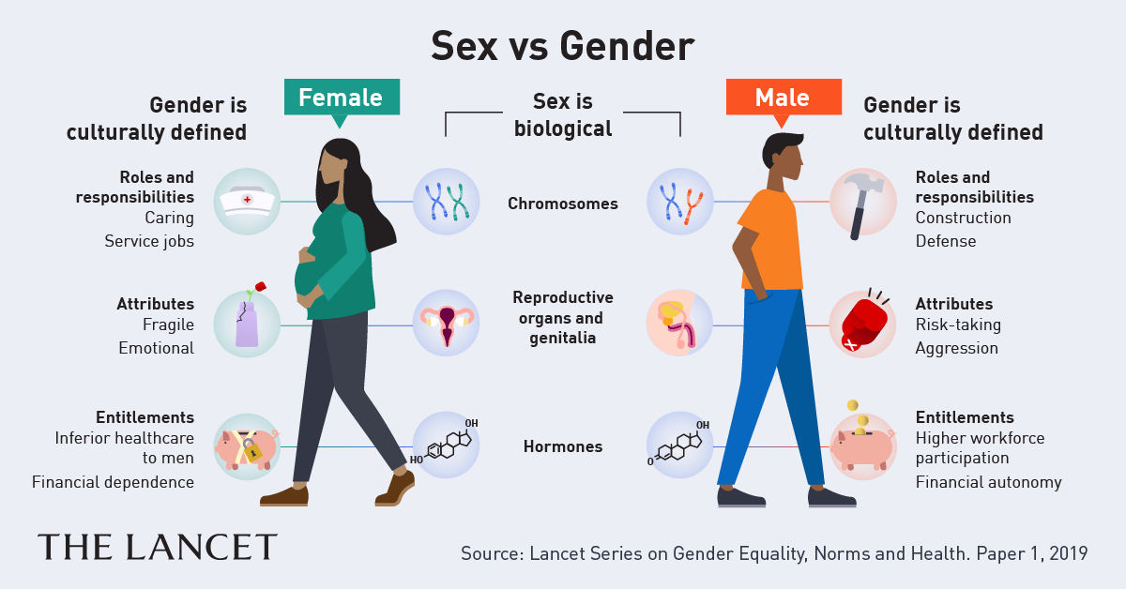
Notes:
Activity 1 – Understanding Gender Identity
Reflection: on your personal identity.
Discussion: It is important to start the conversation on gender inequality with an understanding of gender. Ask participants to consider, are you born a particular gender or do you become a gender? According to the World Health Organisation, ‘Sex’ refers to the biological and physiological characteristics that define men and women. ‘Gender’ refers to the socially constructed roles, behaviours, activities and attributes that society considers appropriate for men and women. To put it another way: ‘male’ and ‘female’ are sex categories, while ‘masculine’ and ‘feminine’ are gender categories.
Step 1 Divide participants into four groups, masculine male, feminine female, masculine female and feminine man, give them each a large sheet of paper and tell them they will be recording the words they feel society uses to describe their category of person.
Call out the following words and ask the groups to write down the words or traits they feel describes their category of person: hairy, muscles, breasts, brave, rough, risk-taker, independent, emotional, curvy, assertive, friendly, cuddly, affectionate, romantic, gentle, confident, tall, moody, strong, rationale, competitive, shy, cooperative, nurturing, pilot, decisive, daring, dominant, short hair, long hair, violent, aggressive, hysterical, indecisive, leader, fighter, healer, pink, cleaner, doctor, teacher, nurse, graceful, short hair, earrings, soft, flirtatious, hips, messy, artsy, scientist, quiet, bold, powerful, insensitive, physical, athlete, stubble, gay, straight, pretty, charming, beautiful, fit, funny, bad, engineer, gamer, footballer.
Step 2: In our society, how would you rate your person in terms of their perceived power, with 1 being weak and 10 being powerful? Who might you give authority or decision making power to? Which person could you perceive as vulnerable or lacking in power? Why? How might that person be treated?
Step 3: Ask participants to count the number of perceived negative characteristics you have on the page. Ask them to circle any words that could be seen as a stereotype of your category of person.
A stereotype is a mistaken idea or belief many people have about individuals or groups, based upon how they look on the outside, which may be untrue or only partly true. When a person is stereotyped, expectations can be placed on them and decisions can be made about them. Stereotyping quite often underpins discrimination and inequality and can even lead internalised beliefs that limit people’s options and expectations of themselves.

Slide 11
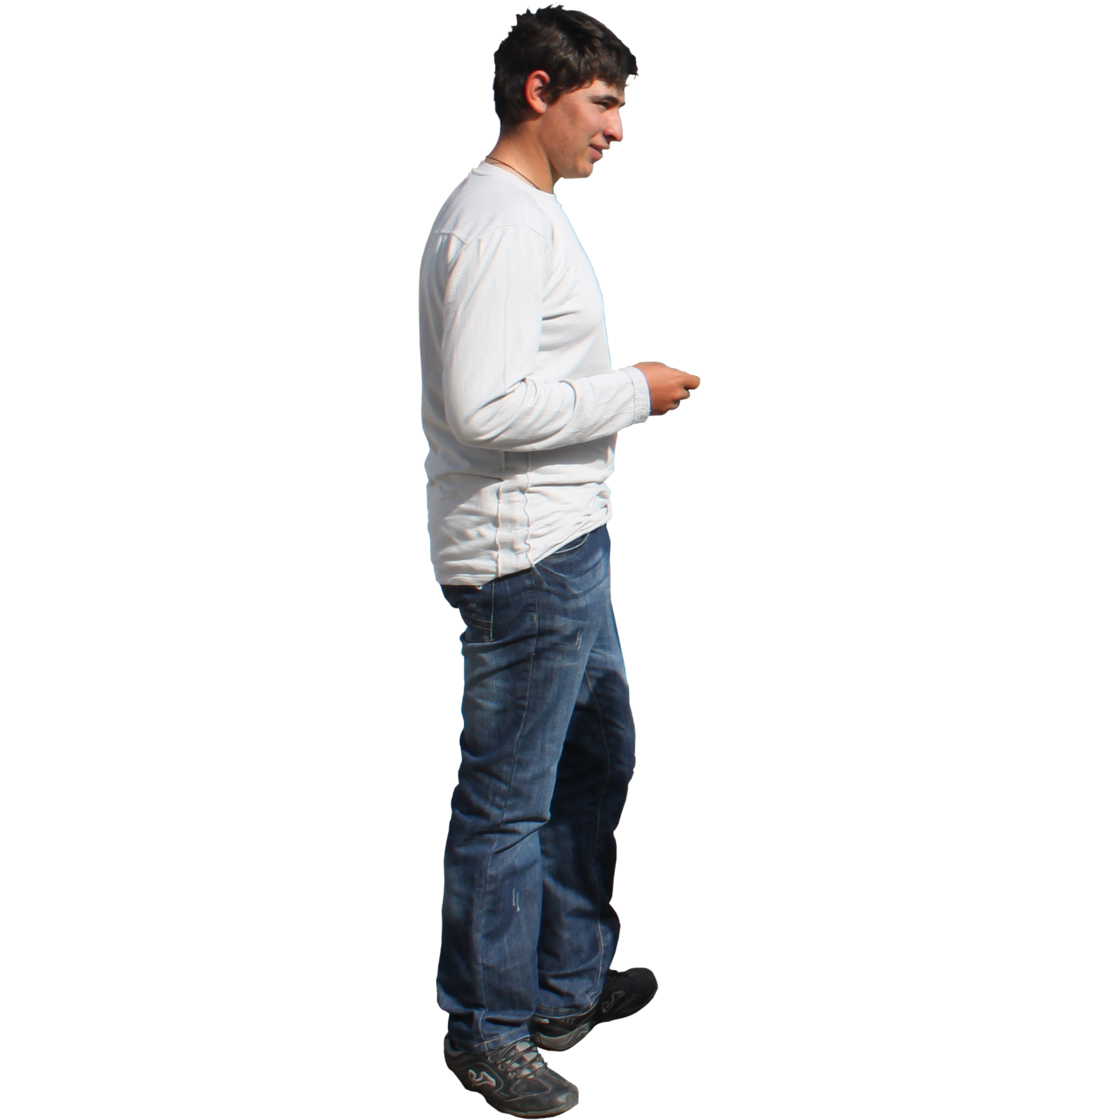
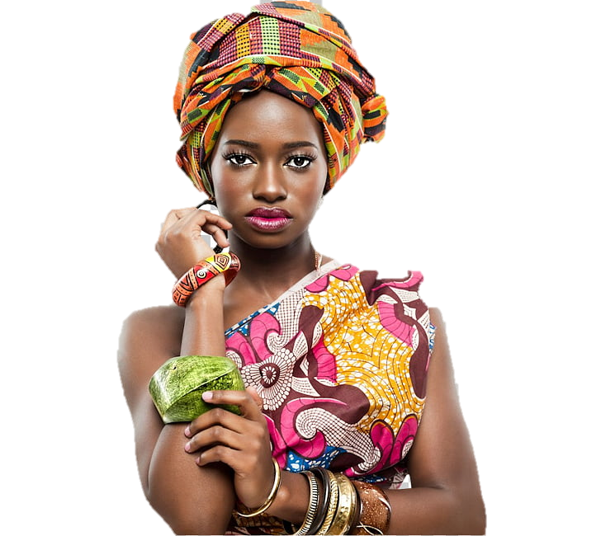
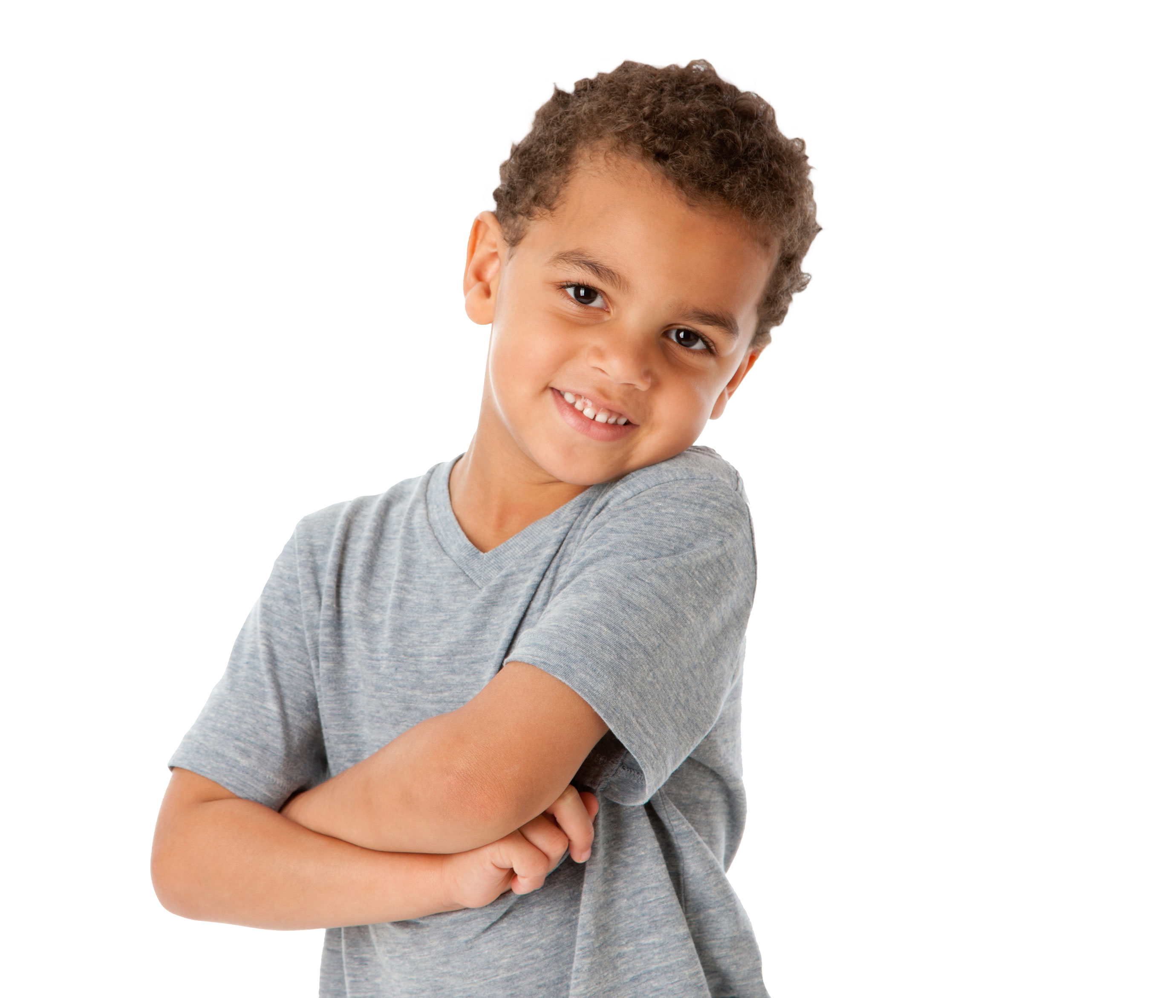
wo
WORLD
IRELAND
SCHOOL
HOME
Notes:
GENDER ROLES
Activity How do gender roles affect how boys and girls experience life?
4 groups - World * Ireland * School * Family
Give each group a flipchart divided in two with a third section for transgender
Feedback: Are their distinct roles do they have different expectations? Is there a gender bias and if so, who does it favour? What implications does this have for this group?
Gender bias is the tendency to prefer one gender over another. It is a form of unconscious bias, or implicit bias, which occurs when one individual unconsciously attributes certain attitudes and stereotypes to another person or group of people.
What supports these roles in our society?

Slide 12
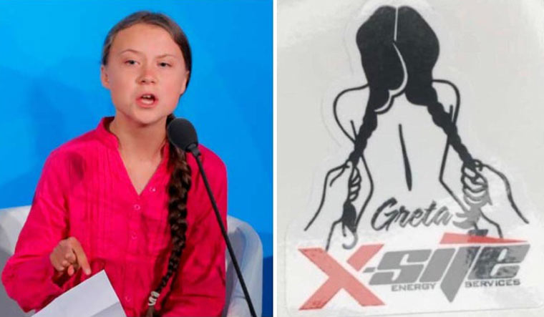
Notes:
The aim of this activity is to explore the impact of sexism.
Sexism is the prejudice, stereotyping, or discrimination, typically against women, on the basis of sex. Institutional sexism is the subordination of one gender (usually women) as part of the everyday workings of economics, law, politics, and other social institutions. This helps to normalise discrimination and abuse. Subordination of women that is part of the everyday workings of economics, law politics, and other social institutions.
Group Work: Ask participants to divide into smaller groups. Watch 1 of the four videos and discuss with the group. Can they think of other examples of institutional sexism? What are the implications of this for society and individuals? Is this an obstacle to the achievement of real gender equality? Feedback to the larger group.

Slide 13
Notes:
Ireland #AWomanInIreland
Belfast rape trial
Panti gate
There’s no doubt that Irish women have more rights than their mothers, grandmothers and great grandmothers, but gender equality in Ireland has yet to be achieved in many areas.Men still dominate the workplace and are the main decision-makers in business and politics while women often find themselves lagging behind when it comes to equal opportunities and income.
Dáil representation
The current female representation in the Dáil (22 per cent) is the highest in the State’s history. The previous Dáil was 15 per cent. Such improvements must be welcomed. Prior to that we hardly ever made double figures. But we are still languishing far behind our western European neighbours. The current figure for Sweden is 46 per cent, Norway 41 per cent, France 40 per cent, Denmark 37 per cent. Italy and Spain, with whom we share a Catholic history, are 36 per cent and 47 per cent respectively. Currently, we are ranked at 81st in the world on this issue. Hence, we should certainly not get too carried away with our recent progress.
Gender pay gap
Still, it is a start – more than is being done in other areas of public life. For example, there is still no obligatory reporting on gender pay gaps, though legislation for this is in train. When it does come in, it is likely to show a gap of about 15-30 per cent, depending upon the sector. That is quite a shocking figure, and little wonder that Von der Leyen seeks to bring in corporate quotas as a push back against this. She may choose to base her recommendations on the Norwegian model of 40 per cent female composition of publicly listed companies – on pain of dissolution for those failing to comply.

Slide 14
Notes:
The aim of this activity is to explore the generational changes that have occurred.
Has society changed over the years? Divide into smaller groups and discuss what has changed since your grandparent's generation, your parent's generation and now? Record both positive and negative changes. Discuss how these changes came about? What has improved the most and what are the biggest challenges to overcome? Feedback to the larger group.

Slide 15
Notes:
Duration: 20 Mins
The aim of this activity is to discuss female empowerment and the characteristics that define empowerment.
Walking Debate: Both women have created music videos they define as empowering for women. Hold a walking debate between which music video best defines women’s empowerment in 2020?
Video: Nicki Minaj Anaconda
Video: Beyoncé If I Were a Boy

Slide 17
Kahoot

