Slide 1
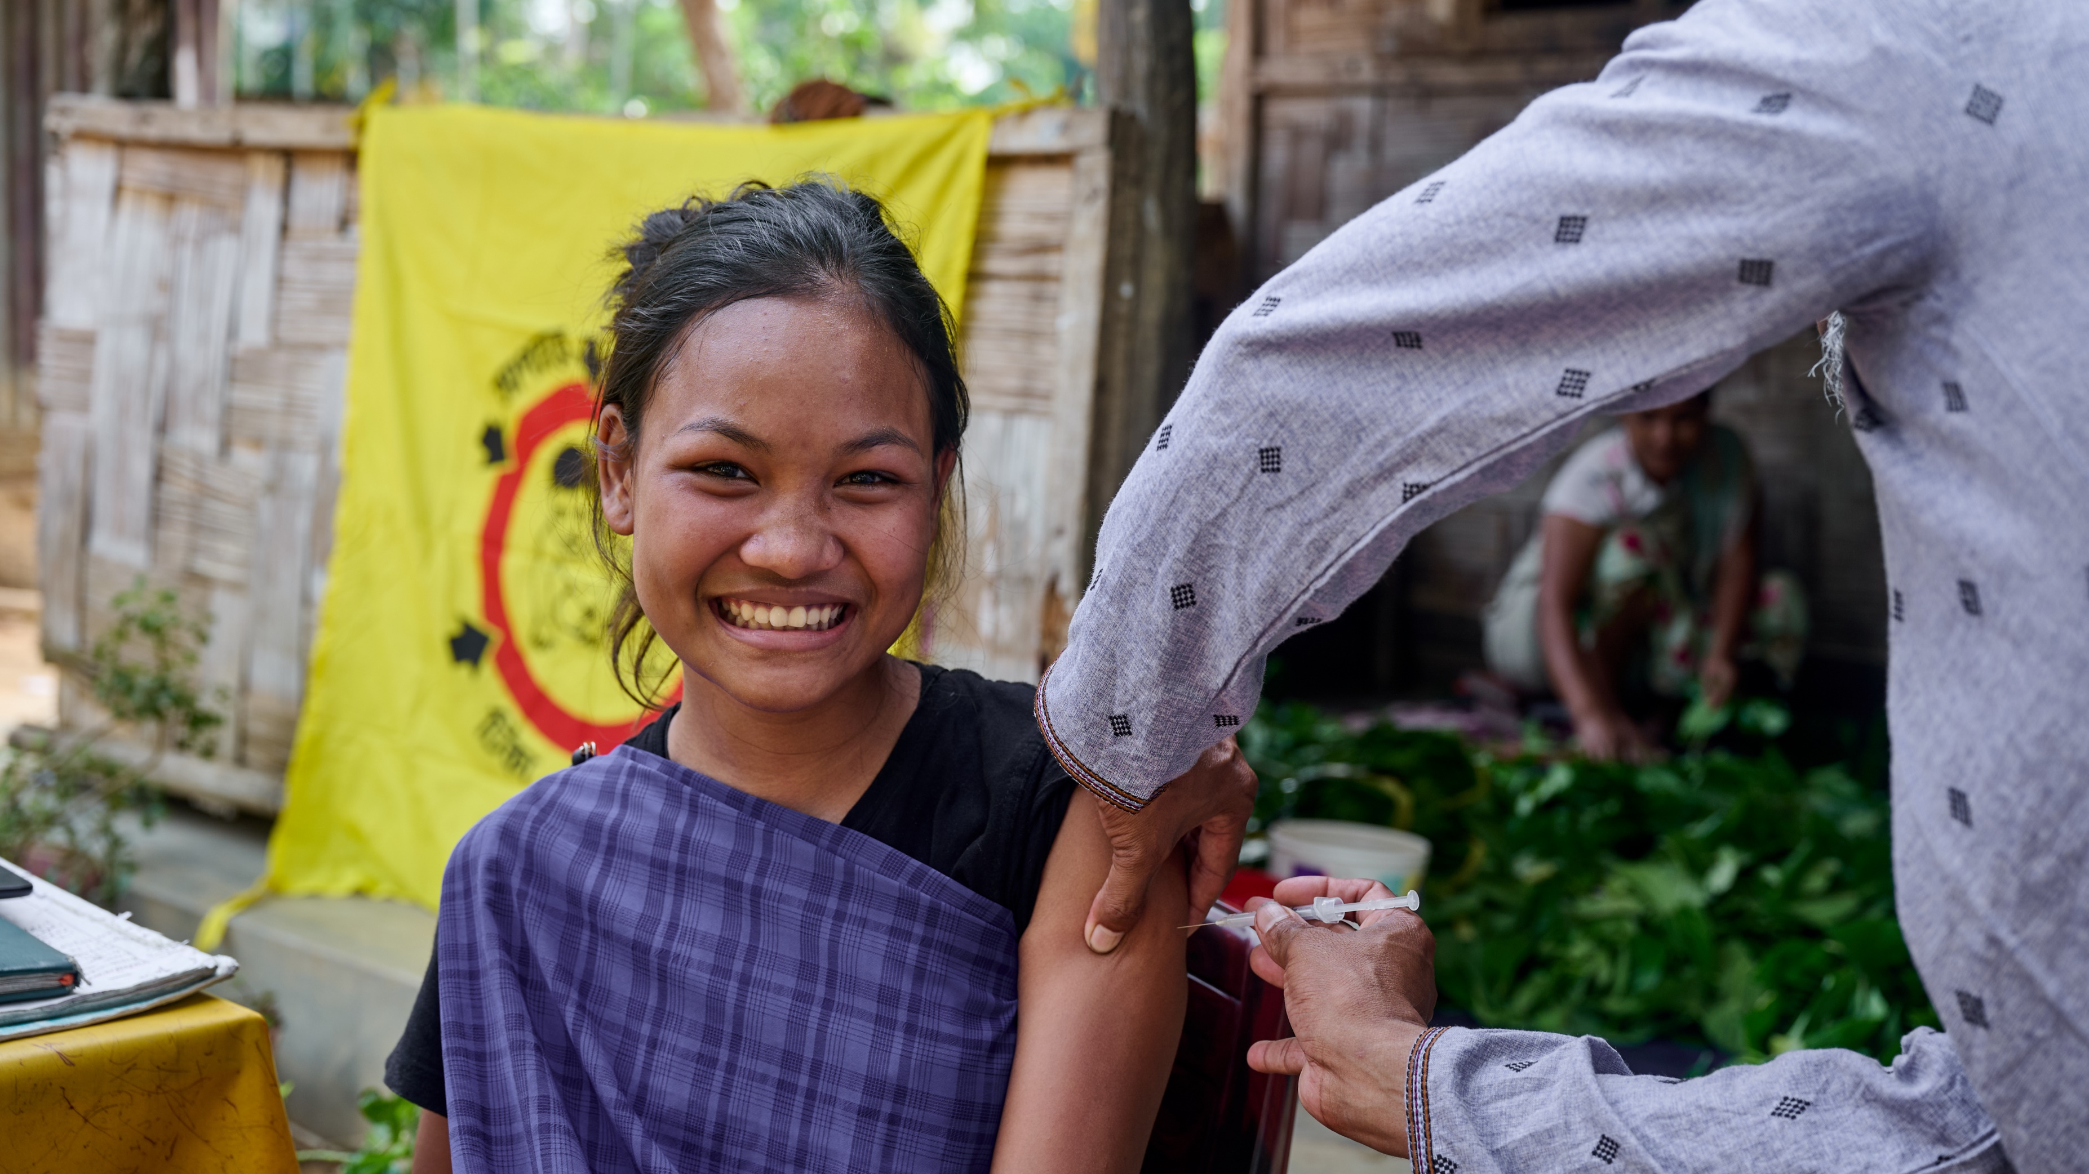
ARTICLE IN FOCUS
UNICEF/UNI561424
Notes:
An adolescent girl receives a vaccine shot at Longlia Chora Punjee (EPI Centre) in Sreemangal, Bangladesh in April 2024

Slide 2
BEFORE YOU BEGIN
Conversations about the issues linked to the use of medicines and drugs can be difficult for children and young people.
Before you begin consider the situations your learners may bring with them into these discussions and have supports and safeguarding measures in place.
Please edit out non relevant slides or activities before sharing with your students. Please check that the content works for your learners and feel free to adapt or add any content that would make the material more relevant for your setting.
This resource was developed by UNICEF UK and adapted by UNICEF Ireland.
Slide 3 – Introducing Articles 24 & 33
Slide 3 – Exploring the Articled
Slides 5 – Some Possible Answers
Slide 6,7,8 – Activities for the classroom
Slide 9 – Reflection
Slide 10– Further Support

Slide 3
ARTICLES 24 & 33
Article 24: Children have the right to the best health care possible, clean water to drink, healthy food and a clean and safe environment to live in. All adults and children should have information about how to stay safe and healthy.
Article 33: Governments must protect children from taking, making, carrying or selling harmful drugs.

Slide 4
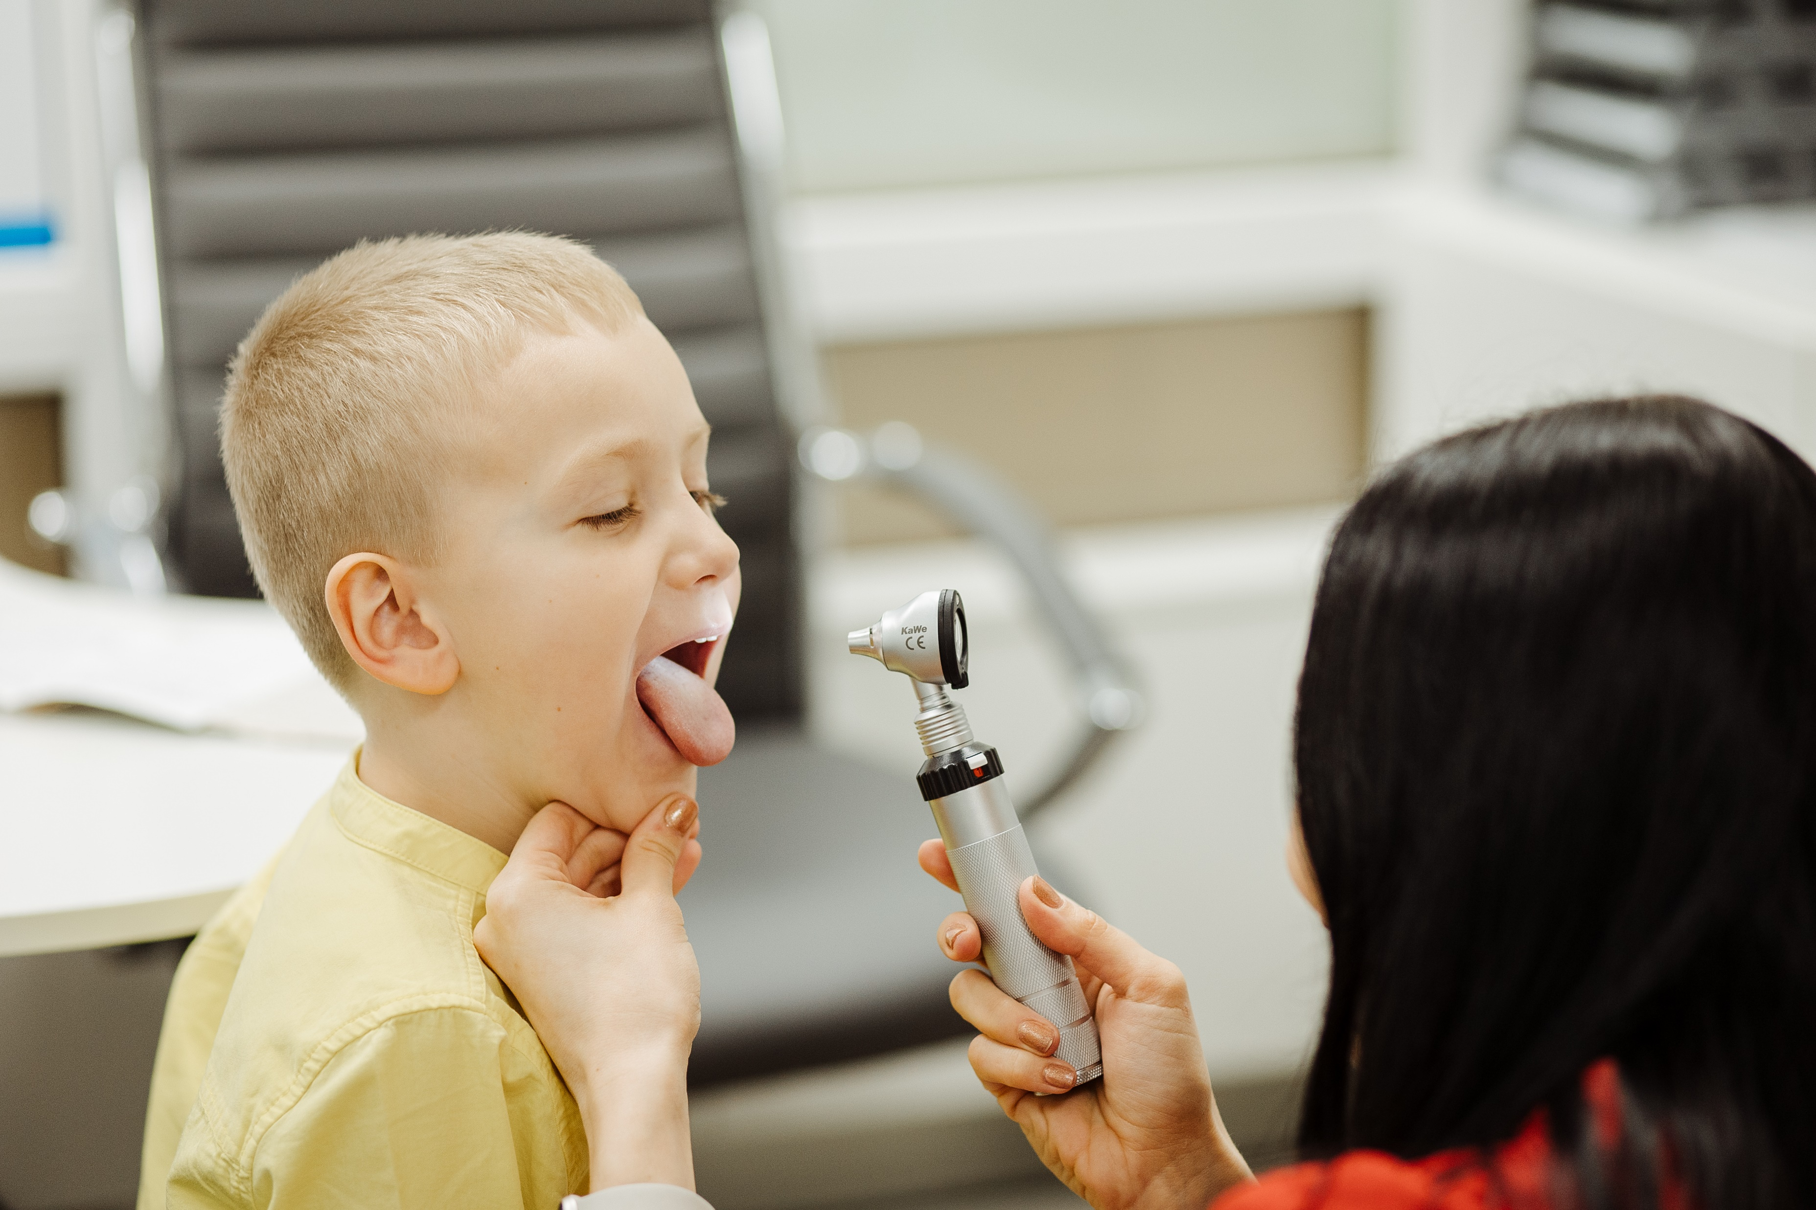
EXPLORING ARTICLES 24 & 33
People use medicines, vaccines and drugs for lots of different positive reasons. What reasons can you think of?
Have a think and write down some answers!
UNICEF/UNI562395
Notes:
Ivan (6) at a medical centre before getting his vaccination, Ukraine, April 2024.

Slide 5
EXPLORING ARTICLE 30
Did you think of these?
To treat an illness.
To protect them from infection and possible illness.
To make sure they get the right vitamins.
To help them sleep better.
To feel relief from pain.
To help treat serious mental ill-health
To protect them from allergies or allergic reaction
What else did you think of?

Slide 6
ACTIVITIES FOR THE CLASSROOM
You do not need to complete every activity but if you have time, you can try to complete more than one.
Think about the different ways you keep healthy. Make a poster to share in school or at home about your favourite activity and how it is good for you! Can you also link this to your rights?
Read or listen to Joe Wicks’ Burpee Bears. Talk about or write down the different things the bears did to help them to be healthy?
Lots of people, things and actions help us to stay healthy or get better when we are unwell or injured. Create a poster listing these, connecting to Article 24. Here are a few ideas to get you started: Doctor, dentist, inhaler, crutches.
Most of us have medicines at home to use when we are poorly. It’s important that these are kept in a safe place so young children cannot access them. Listen to Denver the Dog discuss this further.
Notes:
https://www.youtube.com/watch?v=Rp7S1drKzEk&ab_channel=ARCStories

Slide 7
ACTIVITIES FOR THE CLASSROOM
You do not need to complete every activity but if you have time, you can try to complete more than one.
Drugs and medicines can help your body, but also harm your body. As a class talk about being safe and healthy. Watch this video, and discuss medicines and why taking some substances can be dangerous.
It is illegal to sell cigarettes/vaping products to someone under 18, and smoking has been banned in enclosed public spaces and workplaces. The Government recently announced plans to increase the legal age to purchase cigarettes to 21. As a class, research the impact of smoking and debate whether increasing the legal age would be a good idea.
Discuss in groups what you can do if you are worried about someone’s health.
Who would you talk to? Where can you go for support?
Alexander Fleming discovered penicillin in 1928. Read about him and watch the video in this profile. Research how penicillin and antibiotics are used today. Create a fact file to share the importance of antibiotics

Slide 8
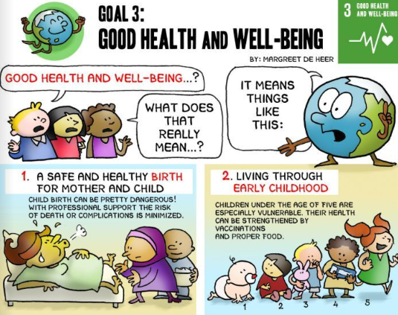
ACTIVITIES FOR THE CLASSROOM
You do not need to complete every activity but if you have time, you can try to complete more than one.
Listen to Salia describe how she coped when her parents were suffering from alcohol addiction, and how she helped other children in similar situations. Salia is incredibly resilient. Create a class display about the things will help nurture resilience.
Look at a summary of the Convention with a friend and discuss which other rights are also linked to your health and wellbeing.
In pairs think of five reasons why children might be tempted to use tobacco, alcohol or illegal drugs. Share your ideas within the class. Act out how you might persuade someone not to smoke, drink alcohol or use illegal drugs.
Global Goal 3 is Good Health and Wellbeing. Look at the comic poster for this goal and think about how this links to Articles 24 and 33. Create your own comic strip to share with your class or the wider school.

Slide 9
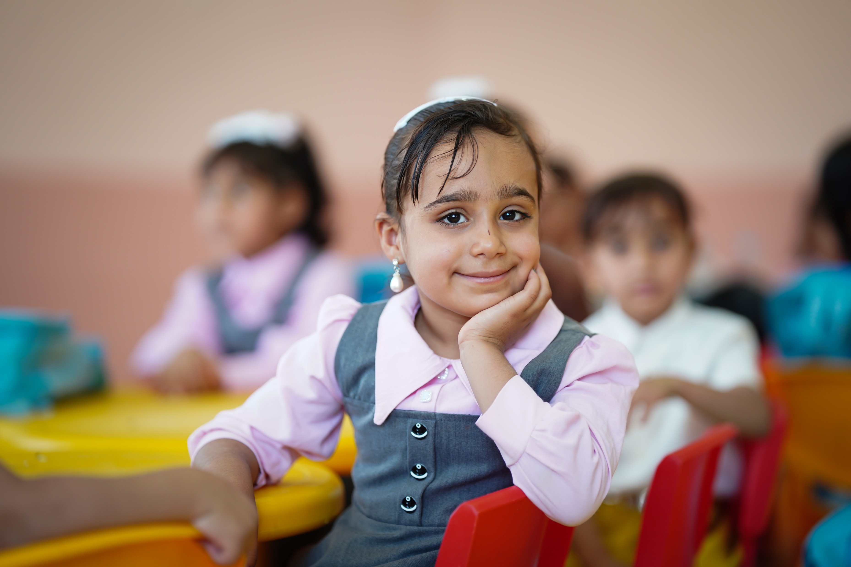
REFLECTION
Find someplace quiet and take a little time to think about the following prompts ….
Think about a time when you were unwell.
Who supported you during this time?
Reflect on all the people and resources that helped you recover and the importance of your right to healthcare.
UNICEF/UNI567711
Notes:
5 years old girl smiling to the camera in the ECE classroom in Salman Al-Mohamadi Primary School in Iraq, 2024

Slide 10
FURTHER CHILD RIGHTS EDUCATION SUPPORT
Child Rights Schools is a programme that supports you to embed child rights across the whole school community, including with parents and carers. Find our more here.
Find more classroom resources here.

Slide 11
THANK YOU!
UNICEF/UNI561995
Notes:
A father and his child share a heartwarming moment at Moddho Nagar, Uktyargaon, EPI centre in Tahirpur, Sunamganj.

