Slide 1
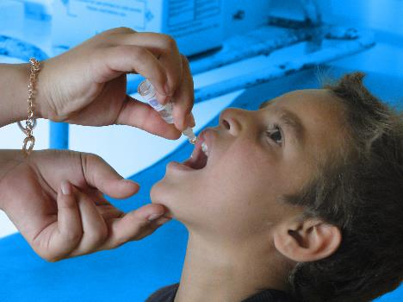
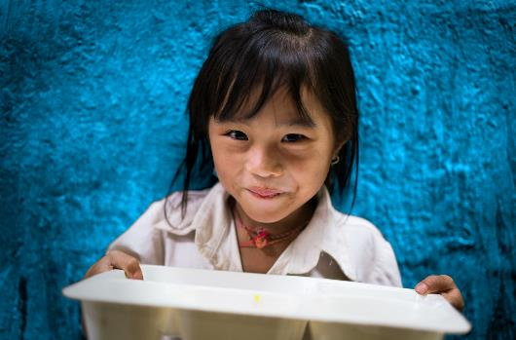
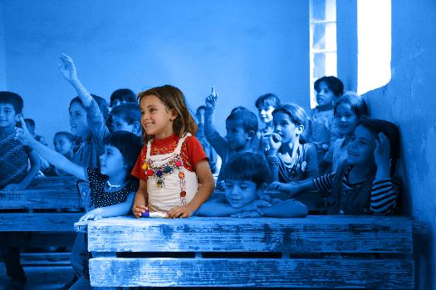
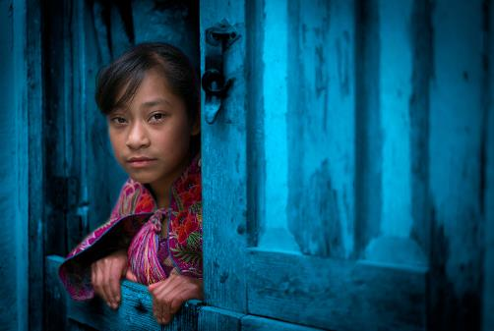
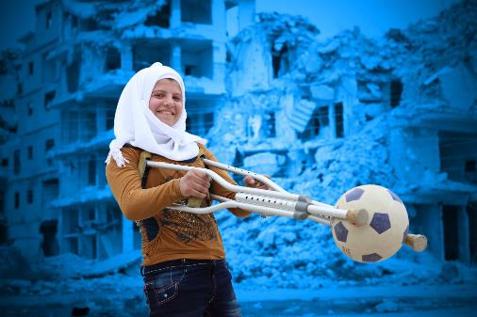
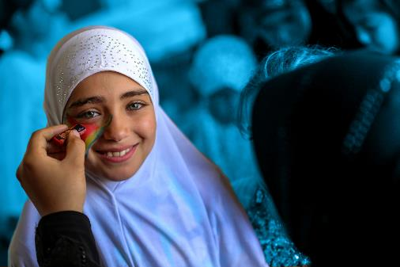
Reduced inequality
Notes:
Delivering this Activity:
You will need:
The United Nations Convention on the Rights of the Child - a few double-sided printed copies
A projector, a screen and a reliable internet connection to show the presentation.
*Please Note: UNICEF encourages peer-led learning. If you are a young person delivering this workshop to your peers, follow the steps below for a successful workshop!
Get support from a teacher or adult to run through the workshop with you first.
If it is a challenging issue, that might cause upset to people, only deliver it with the support of an adult in the room. And also give prior warning to the participants of topic you are covering as they may or may not wish to participate.
Make sure all the technical things (internet, computer connections, etc) are working before the workshop
Follow the notes and use them to talk through each of the slides and show the different videos. Most slides have notes with more info, but don’t worry if you don't share everything in the notes.
Always encourage discussion during the presentation – being sensitive to everyone’s personal experiences and perspectives.

Slide 2
RESPECT
CONFIDENTIALITY
PRIVACY
INCLUSION
AWARENESS
Notes:
Working Well Together - This workshop might touch on some personal experiences you, a family member, or friend has dealt with. ​Because this is an open forum and the discussion might be challenging, please keep in mind the following.
​
RESPECT- Listen when people are speaking, be non-judgmental and respect difference, and don't laugh, deride or make fun of others
CONFIDENTIALITY – Try to ensure that what is said in the room stays in the room
PRIVACY - Only share what we want to share with the group, though we ask for confidentiality, we cannot guarantee it.
INCLUSION – Include everyone, let’s all make sure everybody has an opportunity to contribute if they want to and no one is left out of a group or discussion.
AWARENESS - Be aware this topic might be upsetting If you find the discussion is upsetting you and or you need support please feel free to excuse yourself and find an adult who can support you, be that a teacher, guidance counsellor or a support organisation.

Slide 3
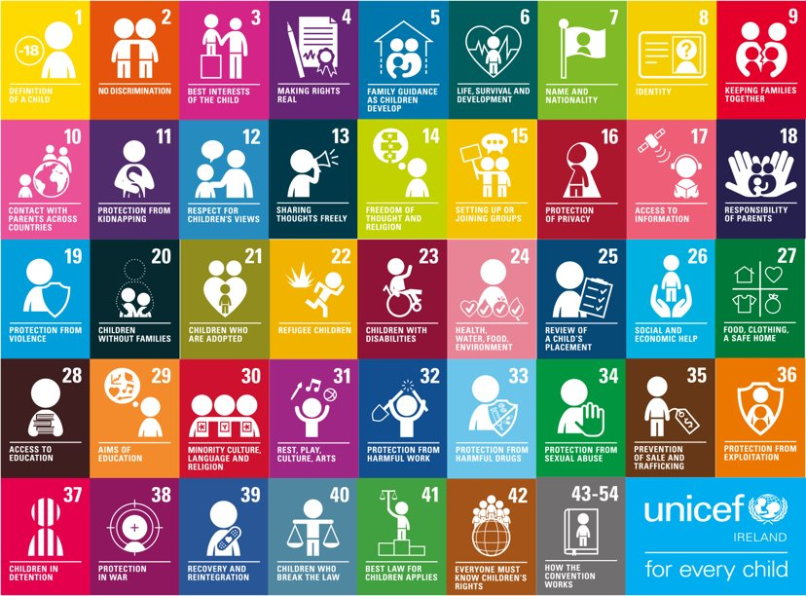
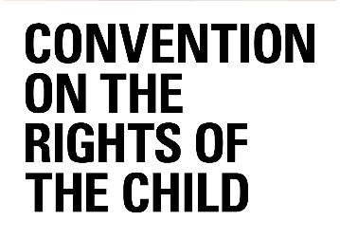
Notes:
1 minute
A child is defined as anyone up to 18 and all children everywhere have the same rights.
Children’s rights are the civil, political, economic, social and cultural rights that all children everywhere are entitled to.
These rights are set out in the United Nations Convention on the Rights of the Child.
All children in Ireland, and around the world, have the same rights – the right to survive, to thrive and to fulfill their potential.
Over recent decades, significant progress has been made in saving children’s lives, getting children into school and lifting people out of poverty. However, much more is needed if children’s rights are to be realized around the world.

Slide 4
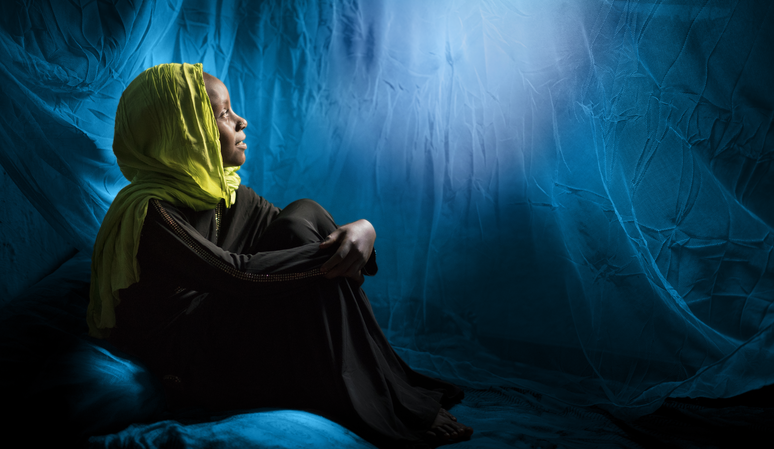
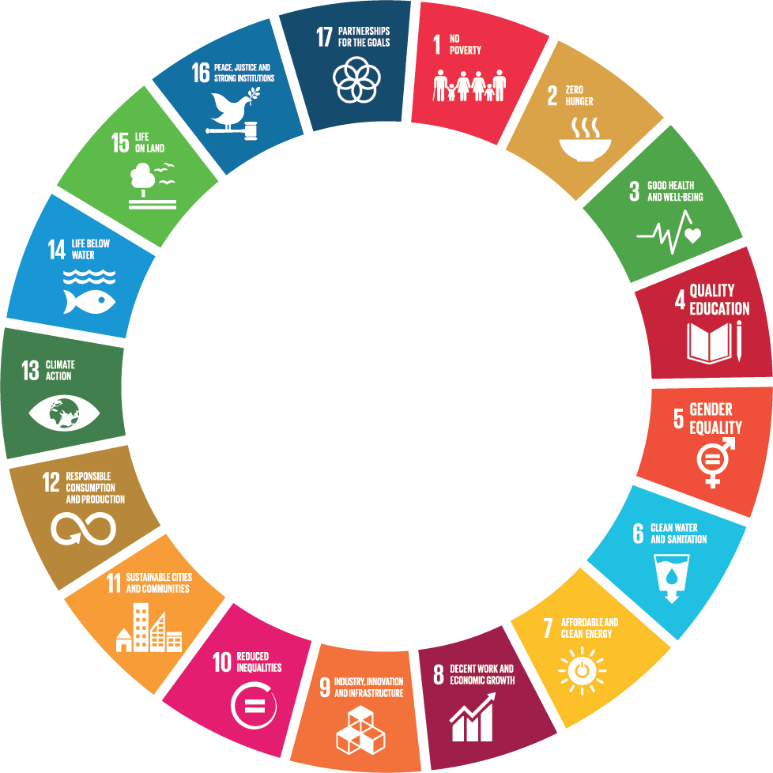
Global
Goals
Notes:
Reducing inequalities Sustainable Development Goal 10
Aim to reduce structural inequalities based on race, gender, ethnicity, religion or socio-economic standings in societies.
2030 targets:
● By 2030, empower and promote the social, economic and political inclusion of all, irrespective of age, sex, disability, race, ethnicity, origin, religion or economic or other status
● Ensure equal opportunity and reduce inequalities of outcome, including by eliminating discriminatory laws, policies and practices and promoting appropriate legislation, policies and action in this regard
● By 2030, progressively achieve and sustain income growth of the bottom 40 percent of the population at a rate higher than the national average

Slide 5
Notes:
Play the video from UNICEF’s Shannen O’Shea

Slide 6
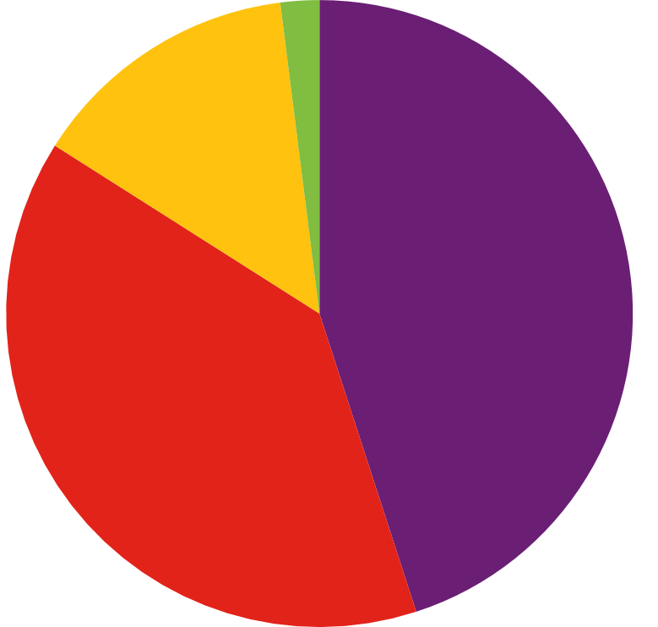
64% of people
THE GLOBAL PICTURE
Top 27% of people
Income inequality between countries has improved since 1990s
However income inequality within countries is getting worse
And income and wealth is increasingly concentrated at the very top
Inequalities common within communities (gender, age, origin, ethnicity, disability, sexual orientation, class, and religion)
Top 1% of people
Top 9% of people
GLOBAL WEALTH
1% of the population owns 45% of the wealth
9% of the population owns 39% of the wealth
27% of the population owns 14% of wealth
64% of the population owns 2% of wealth
Notes:
Today, wherever people live, they don’t have to look far to confront inequalities. Inequality in its various forms is an issue that will define our time.
Overall, since the 1990s total global inequality (inequality across all individuals in the world) declined for the first time since the 1820s. Reinforcing this trend, we have mostly seen income inequality between countries decline.
Yet income inequality within countries has risen, this is the form of inequality people feel on a daily basis.
Income inequality between countries has improved
For the most part we have seen income inequality between countries improve in the last 25 years, meaning average incomes in developing countries are increasing at a faster rate. This can be accredited to strong economic growth in China and other emerging economies in Asia. However, the gap between countries is still considerable. For example, the average income of people living in North America is 16 times higher than that of people in sub-Saharan Africa.
Income inequality within countries is getting worse
Income inequality between countries has improved, yet income inequality within countries has become worse. Today, 71 percent of the world’s population live in countries where inequality has grown. This is especially important because inequalities within countries are the inequalities people feel day to day, month to month, year to year. This is how people stack up and compare themselves with their neighbours, family members, and society. Since 1990, income inequality has increased in most developed countries and in some middle-income countries, including China and India.
Concentrated at the top -> An Oxfam report shows that in the 10 years since the financial crisis, the number of billionaires has nearly doubled, and the fortunes of the world’s super-rich have reached record levels. In 2018, the 26 richest people in the world held as much wealth as half of the global population (the 3.8 billion poorest people), down from 43 people the year before.
Inequalities within communities - Inequalities are not only driven and measured by income, but are determined by other factors - gender, age, origin, ethnicity, disability, sexual orientation, class, and religion. These factors determine inequalities of opportunity which continue to persist, within and between countries. In some parts of the world, these divides are becoming more pronounced. Meanwhile, gaps in newer areas, such as access to online and mobile technologies, are emerging. The result is a complex mix of internal and external challenges that will continue to grow over the next twenty-five years.
Source: https://www.un.org/en/un75/inequality-bridging-divide
Source: https://inequality.org/facts/global-inequality/

Slide 7
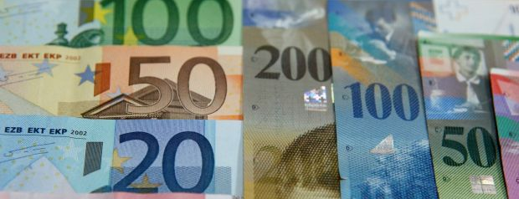
Where do I fall?
Am I part of the global 1%?
Take out your phones, and go to givingwhatwecan.org and take a guess of what your family earns and owns.
Notes:
4 minutes
The survey is at the bottom of the page

Slide 8
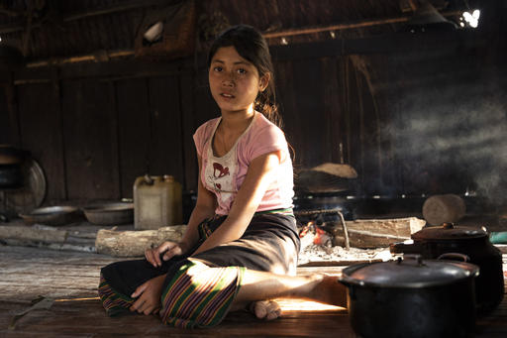
LIFE-LONG CONSEQUENCES
1% of the global population collected 82% of the wealth from 2018, leaving 18% for the remaining 99%
8.6% of the world lives in extreme poverty… that’s almost 600 million people.
Marginalised groups being left behind
Children receive less – the cycle of poverty
Notes:
(Picture on top from “Crazy Rich Asians” movie - it may seem silly, but it is also not an inaccurate portrayal for the level of wealth some families possess. Look at the contrast of lifestyles.)
If 1% has 82% of the wealth, that means there is only 18% of money available for 99% of the population. That would be roughly (2.36*10^-9)% per person (or 0.00000000236% per person), if the remaining 18% is distributed equally… which we know it is not.
10.9% of the world population lives on $1.90 a day, 28.6% live on $3.20, and 48.7% live on $5.50.
Unequal distribution of income counters the fight to end poverty - income inequality feeds poverty and exacerbates social problems such as gender inequality, racial inequality, and the poverty cycle. Why? Because these marginalized groups are more likely to make less money and then be unable to afford a better lifestyle.
The cycle of poverty is a real thing - income inequality prevents parents from providing the opportunities for their children to pursue their passions, develop their skills, and take risks to achieve their career goals because affording food, clothing, and rent is a daily concern that takes precedence. Income inequality means that these people are simply trying to survive, rather than excel. Therefore, youth do not learn the skills they need to make enough to save for movie tickets, family vacations, and a nicer house. So they become poor parents, raise their children the same way they were raised, and the cycle continues.

Slide 9
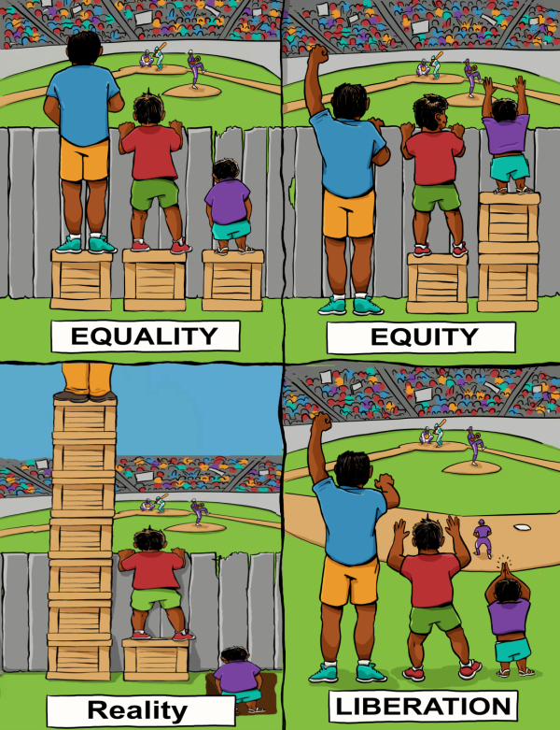
A
B
WHAT DO YOU THINK?
Which picture represents these concepts:
Equity
Reality
Liberation
Equality
C
D
Notes:
So why is equality so difficult to achieve? Can’t we just give everyone the same income every year and everything will sort itself out? Here is a good visual depiction of why sorting income inequality is not as easy as one might think...
The boxes represent the amount of resources, support, and opportunities we are given throughout our lives. In other words, the amount of ‘stuff’ someone gets to push them through life. The wall represents the hurdles we have to overcome just to get by on a daily basis and reach our goals. The height of the individuals represents the different starting points each individual is at based on a myriad of factors such as the gender you are born as, the country you are born in, the family you are born into, etc.
Based on this understanding,
[have participants raise their hands to vote for each picture, then click once to reveal which picture is which]
A - Equality - everyone is given the same amount of ‘stuff’ to be used however the individual sees fit. But some people were naturally born with an advantage, so this amount of “stuff” just lifts them higher so the gap is not resolved.
B - Equity - everyone is given a different amount of ‘stuff’, determined by their need, until everyone is at the same level. This is the best chance for ending inequality, but how can you convince the wealthiest that they should not take any more?
C - Reality - Some are given an excess of ‘stuff’, while the vast majority get little to none of the ‘stuff’. We saw this explained in the video and pie charts already.
D - Liberation - positioning here does not matter, regardless of where you are you get the same access and opportunity. This would mean an eradication of barriers to achieving the same opportunities so everyone, regardless of where they start out in life, can have the same options.

Slide 10
“Poverty is not an accident. Like slavery and apartheid, it is man made and can be removed by the actions of human beings.”
Nelson Mandela
What are the drivers of inequality?
Notes:
Brainstorm why you think the world is becoming more unequal?

Slide 11
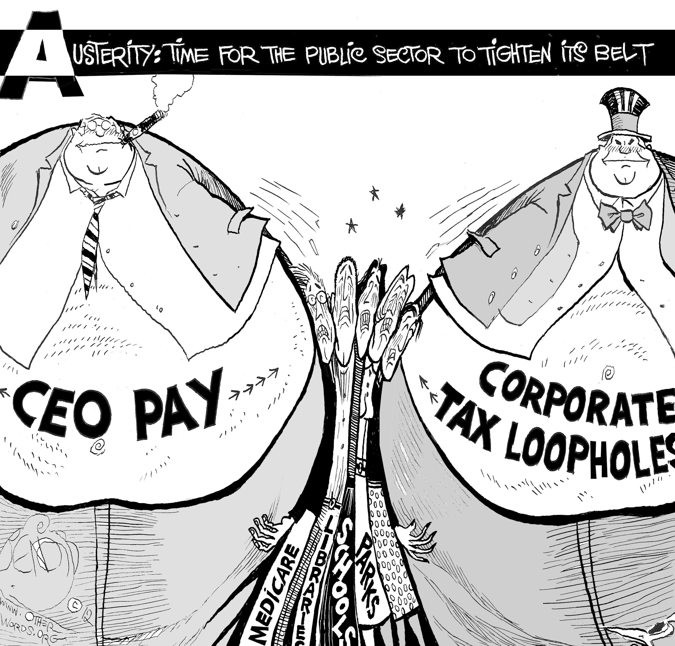
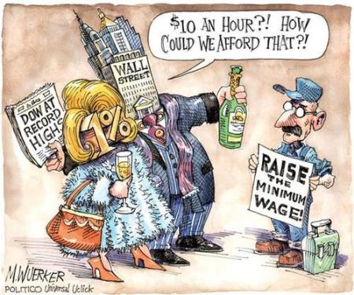
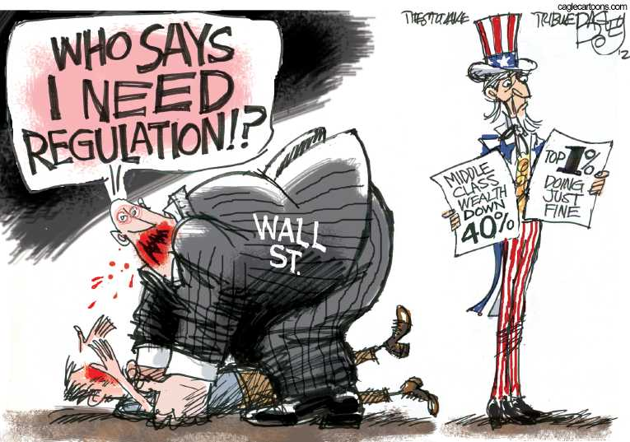
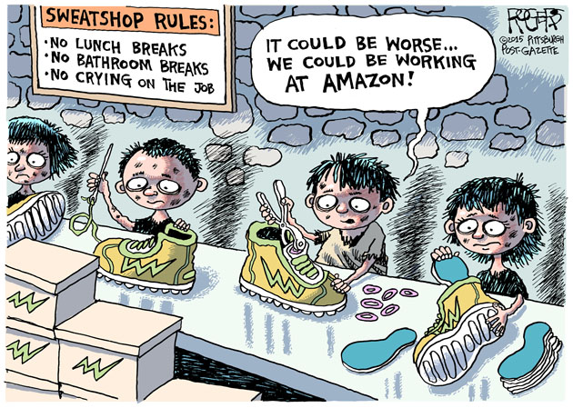
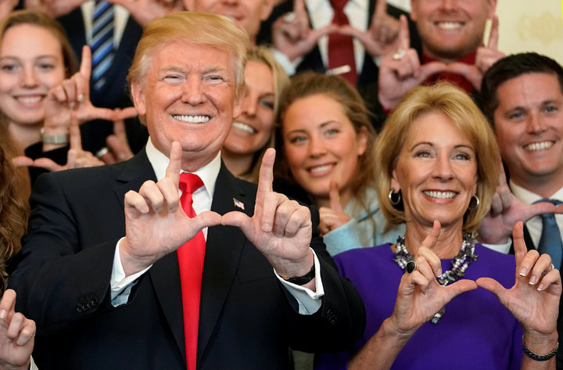
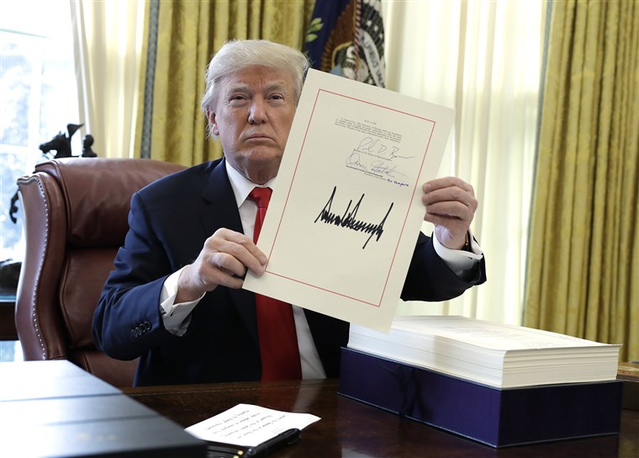
DRIVERS OF INEQUALITY
Wealthy people and business have a disproportionate influence on decision makers
+
Decision makers make the
rules
Notes:
Billionaires around the world, who have almost doubled in number since the 2008 global financial crisis, saw their combined fortunes grow by $2.5bn a day, while the 3.8 billion people at the bottom of the scale saw their wealth decline by 11 percent in 2018
The world's richest man, Amazon CEO Jeff Bezos, saw his fortune increase to $112bn last year, Oxfam said, pointing out that just one percent of his wealth was the equivalent to the entire health budget of Ethiopia, a country of 105 million people.
The report also said women and girls are the hardest hit by rising inequality, as men own 50 percent more of the total global wealth and control 86 percent of corporations.
Why does this matter
Oxfam said getting the world's richest one percent to pay just 0.5 percent extra tax on their wealth could raise more money than it would cost to educate the 262 million children out of school, and provide life-saving healthcare for 3.3 million people.
Undermines democracy

Slide 12
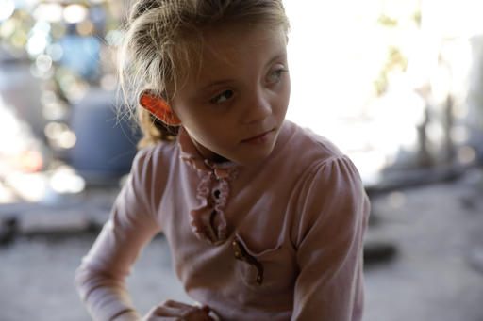
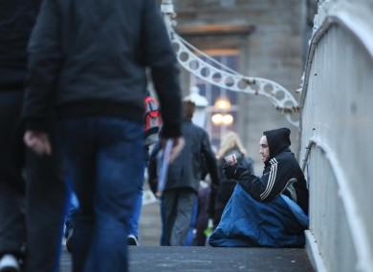
IRELAND IS NOT EXCEMPT…
Ireland has one of the highest inequality rate of any EU country
The Irish government provides more financial support than almost every EU country
Why is it such a big problem?
Low minimum wage
High cost of living
More support for businesses than local people
Notes:
5 minutes
Ireland was ranked 24 in the world for inequality, which does not sound bad, except that all other EU countries are ranked between 1 and 22.
Ireland has some of the highest government welfare and social support for its population. This helps with inequality, but why is Ireland still so high then? Because the amount of money a person makes is so close to the cost of living (meaning food, rent, and clothing for one person).
But there are more businesses coming to Ireland, which means good paying jobs right? Well these businesses do make a lot of money and offer good money to their workers, except that the government supports businesses more than people. Businesses are able to avoid paying taxes and keep most of their money while ordinary workers cannot.
This encourages the inequality between the top 10% of the Irish population and the remaining 80%.
http://www.inequalityindex.com/
The Commitment to Reducing Inequality (CRI) 2018 report produced the following statistics about Ireland:

Slide 14
Evaluation
CLICK HERE
TIME TO KAHOOT!

